Slide 1
Overview of National Trends for Pediatricians and Patients
From:
American Academy of Pediatrics Research
February 2020

Slide 2

Who are US Children?

Slide 3
Overview of Key Trends
US child population
Birth rates
Racial/ethnic composition
Immigrant children
Geographic shifts
Poverty trends

Slide 4

US Child (under 18) Population Trends: Number and % of Overall Population, 1970-2018
22%
Source: US Census Bureau (http://www.childstats.gov/americaschildren/tables/pop1.asp and http://www.childstats.gov/americaschildren/tables/pop2.asp)

Slide 5
US Birth Trends (in Millions of Children Born), 1980-2018*
12% decline
2007 - 2018
2018
*Data for 1980-2017 are final; data for 2018 are preliminary.
Source: CDC/NCHS, National Vital Statistics Reports (data for 1980-2015: https://www.cdc.gov/nchs/data/nvsr/nvsr66/nvsr66_01.pdf;
2016 and beyond: https://www.cdc.gov/nchs/data/nvsr/nvsr67/nvsr67_08-508.pdf and https://www.cdc.gov/nchs/data/vsrr/vsrr-007-508.pdf)

Slide 6
Source: US Census Bureau (http://www.childstats.gov/americaschildren/tables/pop3.asp)

Slide 7
Immigrant Children as Share of All Children, 1920–2050
Actual
Projected
Source: Passel, Jeffrey. “Demography of Immigrant Youth: Past, Present, and Future.” The Future of Children, 2011
Note: “Immigrant children” defined as children under age eighteen who are either foreign-born or U.S.-born to immigrant parents;
Gray shaded region (2020-2050) refers to population projections

Slide 8
Total Foreign-Born as Share of Total Population and Immigrant Children as Share of All Children, 1920–2050
Actual
Projected
Source: Passel, Jeffrey. “Demography of Immigrant Youth: Past, Present, and Future.” The Future of Children, 2011
Note: “Immigrant children” defined as children under age eighteen who are either foreign-born or U.S.-born to immigrant parents;
Gray shaded region (2020-2050) refers to population projections

Slide 9
% of US Children (ages 5-17) Who Speak a Language Other Than English at Home, 1979-2017
Source: US Census Bureau, Current Population Survey and American Community Survey
(http://www.childstats.gov/americaschildren/tables/fam5.asp)

Slide 10
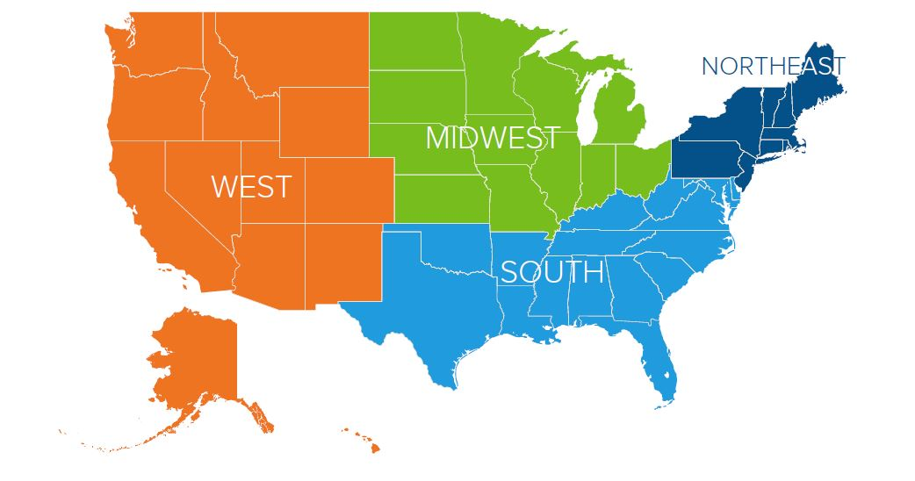
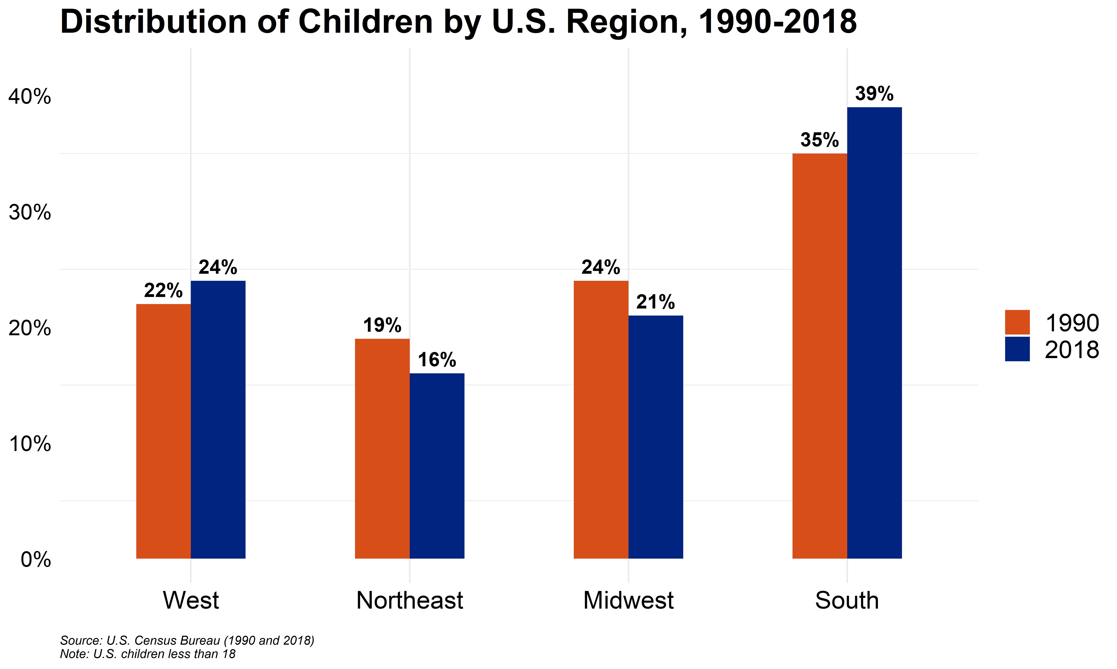

Slide 11
2018
Source: US Census Bureau, Current Population Survey, Annual Social and Economic Supplement (https://www.census.gov/content/dam/Census/library/publications/2019/demo/p60-266.pdf)

Slide 12
2018
Source: US Census Bureau, Current Population Survey, Annual Social and Economic Supplement (https://www.census.gov/content/dam/Census/library/publications/2019/demo/p60-266.pdf)

Slide 13

Who are US Pediatricians?

Slide 14
Overview of Key Trends
Substantial gender shift
Shift toward subspecialty careers
Employees in larger practice settings
High satisfaction with career
High frustration with administrative burdens

Slide 15
US Medical School First-Year Enrollment
Source: AAMC Applicants and Matriculants Data https://www.aamc.org/download/492954/data/factstablea7_2.pdf

Slide 16
% Female: Top 12 Specialties
Specialty | Female %
Pediatrics Obstetrics/Gynecology Geriatric Medicine Endocrinology | 63 57 53 49
Dermatology Rheumatology Infectious Disease Family Med. / General Practice | 49 45 41 40
Psychiatry Allergy and Immunology Internal Medicine Anatomic / Clinical Pathology | 39 38 38 38
Source: AMA Masterfile 2017 / AAMC (www.aamc.org/data/workforce/reports/492560/1-3-chart.html)

Slide 17

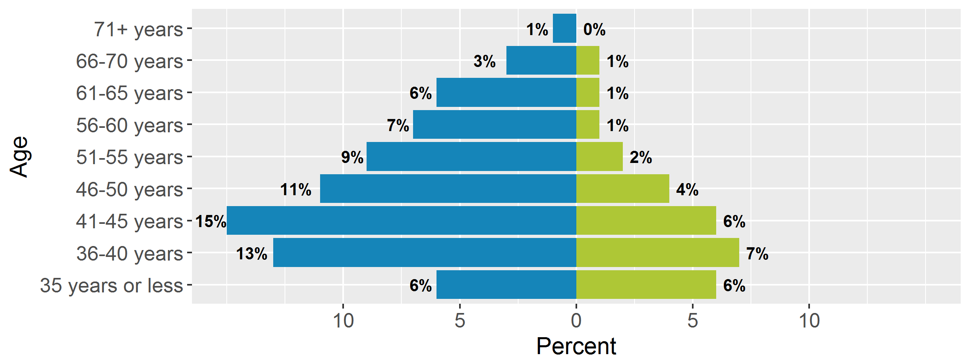
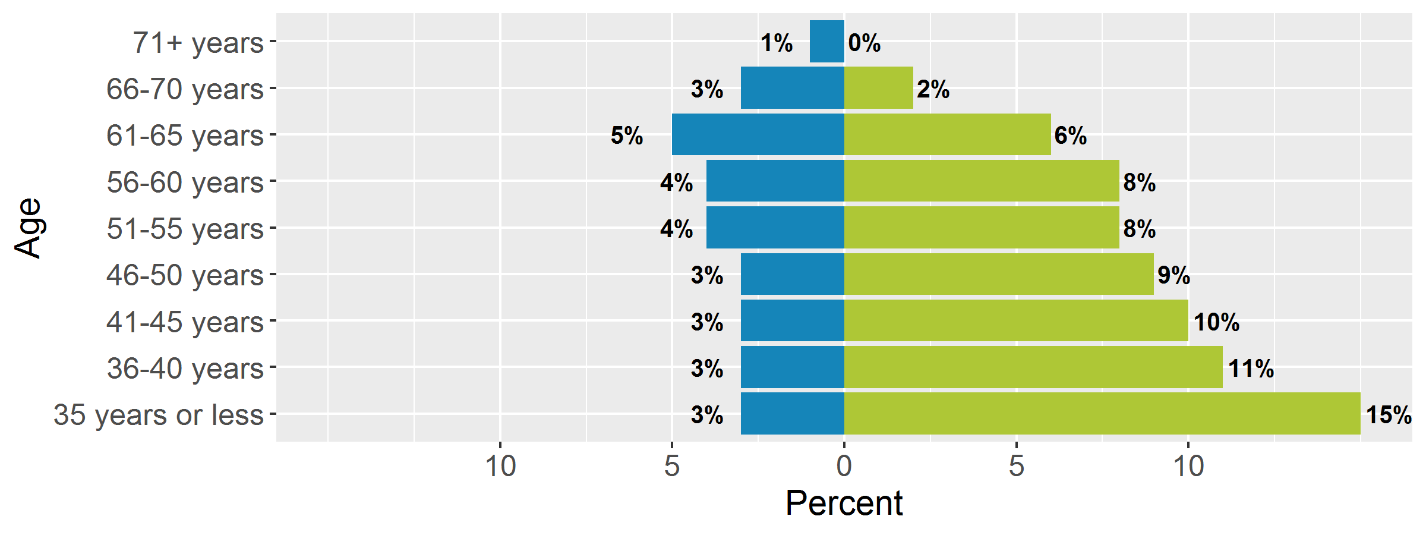
Age & Gender Distribution of Pediatricians: 1987-89 & 2017-19
1987-89
(28% female)
2017-19
(69% female)
Source: AAP Periodic Survey 1987-1989 and 2017-2019
Note: Resident and senior members excluded

Slide 18
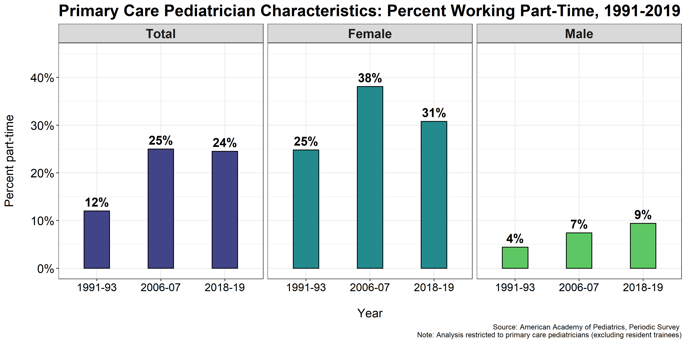

Slide 19
Early Career Pediatricians less likely to pursue primary care
From about 70% of residents in 1998 to one-third today
Similar trend for men and women
Notes:
AAP Graduating Resident Survey, 1998-2019

Slide 20
Percentage of graduating pediatric residents whose future clinical practice goal is primary care
Source: AAP Annual Survey of Graduating Residents, 1997-2019

Slide 21
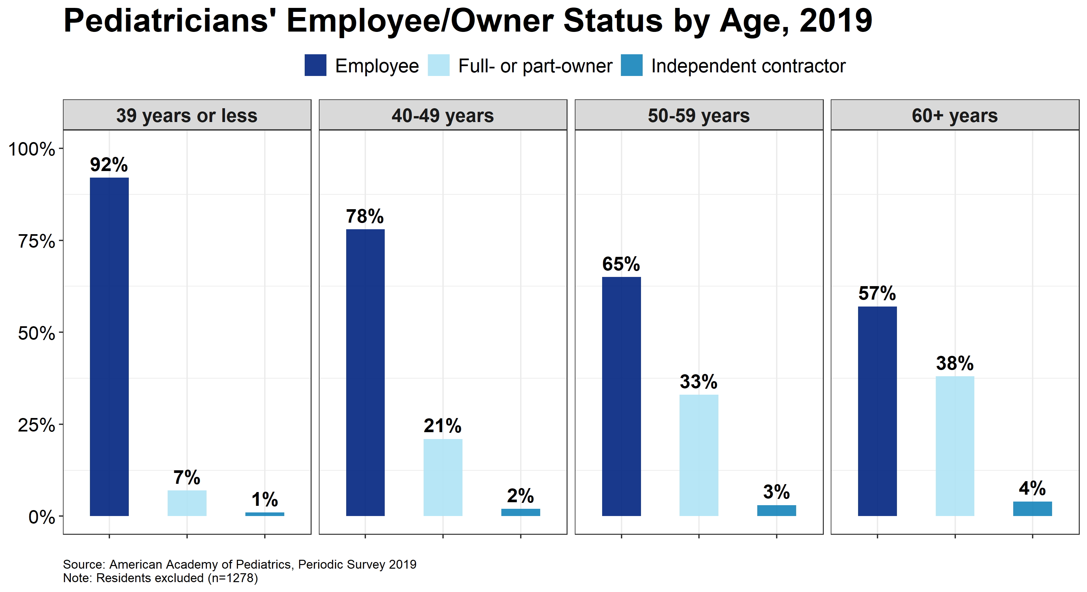

Slide 22
Pediatricians are very satisfied with being a pediatrician
Nearly all graduating residents report they would choose pediatric residency again
Consistent across decades: High satisfaction with career and position
Significant minority report burnout

Slide 23
% of Graduating Pediatric Residents Who Report They Would Choose a Categorical Pediatric Residency Again
Source: AAP Annual Survey of Graduating Residents, 2003-2019

Slide 24
Satisfaction with Career as a Pediatrician:
Member Views 1987 & 2018
84%
88%
Source: Periodic Survey #2 and #100

Slide 25
PLACES Pediatricians (Early to Mid Career) Who Reported Burnout, Career Dissatisfaction, or Often Sad or Depressed, 2019
Source: PLACES Annual Survey 8, 2019; n=1430
Notes:
Annual Survey 8 (2002-04 and 2009-11 residency graduate cohorts) n=1430. Burnout question: I am experiencing burnout in my work - strongly agree or agree. Sad or depressed question: In the past year, how often have you felt sad or depressed? Fairly or very often. Career Dissatisfaction question: All things considered, I am satisfied with my career as a physician – strongly disagree or disagree.

Slide 26
Reflections?
Questions?

