Slide 1



Pediatrics 2025:
The AMSPDC Workforce Initiative
October 23, 2020
1:30pm – 5:30pm ET
Summit # 2
We will begin momentarily.
@AMSPDC
#Peds2025Workforce

Slide 2
Pediatrics 2025: The AMSPDC Workforce Initiative
Pediatrics 2025:
The AMSPDC Workforce Initiative
Welcome
Sherin Devaskar, MD
President, AMSPDC
@AMSPDC
#Peds2025Workforce

Slide 3

















AMSPDC Workforce Summit #2 - Attendees
NextGenPediatricians
#FuturePedsRes
Pediatrics 2025: The AMSPDC Workforce Initiative
@AMSPDC
#Peds2025Workforce

Slide 4
AMSPDC Workforce Summit #2 - Attendees
#FuturePedsRes: Dr. Mekala Neelakantan
#FuturePedsRes:Dr. Nicholas Heitkamp
AAAP: Ms. Sandie Bolina
AAAP: Ms. Liz McCarty
AACOM: Dr. Paul Bowman
AACOM: Dr. Robert Cain
AAMC: Dr. Michael Dill
AAP: Mr. Mark Del Monte
AAP: Dr. Anne Edwards
AAP: Mr. James Baumberger (for domain 3)
ABP: Dr. Laurel Leslie
ABP: Mr. Adam Turner
ABP: Dr. Suzanne Woods
AMSPDC: Dr. Michael Artman
AMSPDC: Dr. Mary Leonard
AMSPDC: Dr. Ann Reed
AMSPDC: Dr. Joe St. Geme, III
AMSPDC: Dr. Sherin Devaskar
AMSPDC: Dr. Bob Vinci
AMSPDC: Dr. Leslie Walker-Harding
AMSPDC: Dr. D. Wade Clapp
AMSPDC: Ms. Laura Degnon
AMSPDC: Dr. John Barnard
APA: Dr. Teri Turner
APA: Dr. Paul Chung
APA: Dr. Latha Chandran
APPD: Dr. Becky Blankenburg
APPD: Dr. Javier Gonzalez del Rey
APPD: Dr. Patricia Poitevien
APS: Dr. Clifford Bogue
CHA: Dr. Amanda Major
COMSEP: Dr. Joseph Gigante
COMSEP: Dr. Rachel Thompson
CoPS: Dr. Jill Fussell
CoPS: Dr. Debra Boyer
CoPS: Dr. Angie Myers
CoPS/ABP: Dr. Audrea Burns
Futuregenpeds: Dr. Xavier Williams
Independent: Dr. Gary Freed
NAM: Karen Helsing
NAPNAP: Dr. Anderea Kline
NAPNAP: Dr. Kristin Gigli
NIH: Dr. Rohan Hazra
SPR: Dr. Stephanie Davis
Scribe: Ms. Erin Ross
Scribe: Ms. Tiffany Chen
Pediatrics 2025: The AMSPDC Workforce Initiative
@AMSPDC
#Peds2025Workforce

Slide 5
Pediatrics 2025: The AMSPDC Workforce Initiative
Pediatrics 2025:
The AMSPDC Workforce Initiative
October 23, 2020
Summit # 2
Initiative Co-Leads:
Bob Vinci, MD, Board Member
Laura Degnon, CAE, Executive Director
@AMSPDC
#Peds2025Workforce

Slide 6
Pediatrics 2025: The AMSPDC Workforce Initiative
AMSPDC Workforce Summit # 1 - Goals
Increase the number of diverse, high-quality students who enter training in our categorical Pediatrics, Medicine-Pediatrics and Combined Pediatric Subspecialty training programs.
Improve recruitment of pediatric residents into pediatric fellowship programs, with an emphasis on those fellowship programs that are not filling their training positions.
@AMSPDC
#Peds2025Workforce

Slide 7
Pediatrics 2025: The AMSPDC Workforce Initiative
AMSPDC Workforce Summit # 1- Objectives
Understand current workforce data and recent trends related to categorical pediatric residency training and fellowship programs.
Ιdentify the gaps in our current data system and the challenges with reviewing workforce data.
Identify questions, for subsequent data analysis, that will add important information to the dialogue regarding the pediatric workforce.
Develop potential action steps that focus on key strategies to improve the pediatric workforce.
Articulate a timeline for our work, subsequent meetings and topics for future consideration.
@AMSPDC
#Peds2025Workforce

Slide 8
Pediatrics 2025: The AMSPDC Workforce Initiative
AMSPDC Workforce Summit # 1
Outcome = Domains and Leads
Domain 1: Changing the Educational Paradigm, with Impact on Attracting Trainees into Pediatrics and Undersubscribed Pediatric Subspecialties
  Domain Lead: Dr. Becky Blankenburg, Association of Pediatric Program Directors (APPD)
Domain 2: Workforce Data/Needs and Access
  Domain Lead: Drs. Laurel Leslie and Jill Fussell, American Board of Pediatrics (ABP) and Council of Pediatric Subspecialties (CoPS) Through Their Virtual Workforce Network
Domain 3: Economic Strategies
  Domain Lead: Dr. Mary Leonard, Association of Medical School Pediatric Department Chairs (AMSPDC)
Domain 4: Other Considerations for Attracting Medical Students into Pediatrics
  Domain Lead: Dr. Joe Gigante, Council on Medical Student Education in Pediatrics (COMSEP)
@AMSPDC
#Peds2025Workforce

Slide 9
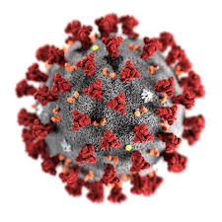

Pediatrics 2025: The AMSPDC Workforce Initiative
AMSPDC Workforce Summit # 1
Summary of “Domains”
Domain 1: Changing the Educational Paradigm, with Impact on Attracting High Quality, Diverse Trainees into Pediatrics and Undersubscribed Pediatric Subspecialties
  Domain Lead: Dr. Becky Blankenburg, Association of Pediatric Program Directors (APPD)
Domain 2: Workforce Data/Needs and Access
  Domain Lead: Drs. Laurel Leslie and Jill Fussell, American Board of Pediatrics (ABP) and Council of Pediatric Subspecialties (CoPS) Through Their Virtual Workforce Network
Domain 3: Economic Strategies
  Domain Lead: Dr. Mary Leonard, Association of Medical School Pediatric Department Chairs (AMSPDC)
Domain 4: Other Considerations for Attracting High Quality, Diverse Medical Students into Pediatrics
  Domain Lead: Dr. Joe Gigante, Council on Medical Student Education in Pediatrics (COMSEP)
@AMSPDC
#Peds2025Workforce

Slide 10
Workforce Pipeline
Fellowship Pediatric Subspecialty
Residency
in Pediatrics
Medical School
Allopathic/Osteopathic
College
Middle and High School
Fewer physician scientists
Critical shortage of some subspecialties
Relatively rapidly growing subspecialties
~ fewer MD graduates selecting Pediatrics
~ 70%
make decision
~ Growth of osteopathic schools
@AMSPDC
#Peds2025Workforce
Pediatrics 2025: The AMSPDC Workforce Initiative

Slide 11
Pediatrics 2025: The AMSPDC Workforce Initiative
Agenda
Share ideas, offer advice, ask questions, share contacts/connections
1:30-1:35pm Welcome, Introductions (S Devaskar, AMSPDC)
1:35-1:50pm Initiative Update: (B Vinci; L Degnon, AMSPDC)
1:50-2:10pm Domain 1 Update of Work Accomplished, Key Areas of Focus, Collaborations, Short/Long Term Goals, Overall Domain Workplan (B Blankenburg, APPD)
2:10-2:15pm Clarifying Questions
2:15-2:30pm Small Breakouts: Advice you have; ideas
2:30-2:35pm Report out, key points
2:35-2:55pm Domain 2 Update of Work Accomplished, Key Areas of Focus, Collaborations, Short/Long Term Goals, Overall Domain Workplan (L Leslie; J Fussell, ABP/CoPS Workforce Virtual Network)
2:55-3:00pm Clarifying Questions
3:00-3:15pm Small Breakouts: Advice you have; ideas
3:15-3:20pm Report out, key points
3:20-3:35pm Break
@AMSPDC
#Peds2025Workforce

Slide 12
Pediatrics 2025: The AMSPDC Workforce Initiative
Agenda
Share ideas, offer advice, ask questions, share contacts/connections
3:35-3:55pm Domain 3 Update of Work Accomplished, Key Areas of Focus, Collaborations, Short/Long Term Goals, Overall Domain Workplan (M Leonard, AMSPDC)
3:55-4:00pm Clarifying Questions
4:00-4:15pm Small Breakouts: Advice you have; ideas
4:15-4:20pm Report out, key points
4:20-4:40pm Domain 4 Update of Work Accomplished, Key Areas of Focus, Collaborations, Short/Long Term Goals, Overall Domain Workplan (J Gigante, COMSEP)
4:40-4:45pm Clarifying Questions
4:45-5:00pm Small Breakouts: Advice you have; ideas
5:00-5:05pm Report out, key points
5:05-5:30pm Group Discussion; Next Steps (B Vinci; L Degnon, AMSPDC)
5:30pm Adjourn
@AMSPDC
#Peds2025Workforce

Slide 13
Pediatrics 2025: The AMSPDC Workforce Initiative
Accomplishments Since February 2020
Domains Refined and Leads Established
Governance Structure
Partnerships with other organizations
Website
Approval for a Series of Publications via AMSPDC in Journal of Pediatrics
Each Domain Will Give Specific Updates on Accomplishments
@AMSPDC
#Peds2025Workforce

Slide 14
Pediatrics 2025: The AMSPDC Workforce Initiative
Goals For Today
Increased Collaboration in Pediatrics Community
Updates on Work Done Since February
Presentations on each Domain
Breakouts to receive input to strengthen our work
Summary and Next Steps
Reminder: This is a 5-year project; change we’re seeking won’t happen overnight. We need this Initiative to be a thoughtful, collaborative effort.
@AMSPDC
#Peds2025Workforce

Slide 15
Pediatrics 2025: The AMSPDC Workforce Initiative
Governance
Advisory Committee
  Purpose: The Advisory Committee is designed to help ensure close communication within each and across domains. This Committee will deliberate, make decisions, advise, provide strategic oversight, ensure inclusiveness and collaboration in the pediatrics community, review the goals, timelines, reports and serve as advocates for this Initiative.
  Commitment: Five years; quarterly Advisory Committee calls; periodic emails; attend the AMSPDC sponsored workforce summits.
  Members: Bob Vinci and Laura Degnon (Initiative Co-Leads)
  Sherin Devaskar (AMSPDC President); March 2021 Ann Reed
  Leslie Walker-Harding and Joe St. Geme (AMSPDC Leaders)
  Becky Blankenburg (Domain 1 Lead)
  Jill Fussell and Laurel Leslie (Domain 2 Leads)
  Mary Leonard (Domain 3 Lead)
  Joe Gigante (Domain 4 Lead)
@AMSPDC
#Peds2025Workforce

Slide 16
Pediatrics 2025: The AMSPDC Workforce Initiative
Governance
Steering Committee
  Purpose: The Steering Committee is designed to help ensure the work within each domain moves forward in a thoughtful, collaborative manner. It’s essential each domain has close communication with the other domains. This Committee will deliberate, advise, provide strategic suggestions, ensure inclusiveness and collaboration in the pediatrics community, and serve as advocates for this Initiative.
  Commitment: Five years; monthly Steering Committee calls; periodic emails; attend the AMSPDC sponsored workforce summits.
  Members: Bob Vinci and Laura Degnon (Initiative Co-Leads)
  Becky Blankenburg (Domain 1 Lead)
  Jill Fussell and Laurel Leslie (Domain 2 Leads)
  Mary Leonard (Domain 3 Lead)
  Joe Gigante (Domain 4 Lead)
@AMSPDC
#Peds2025Workforce

Slide 17
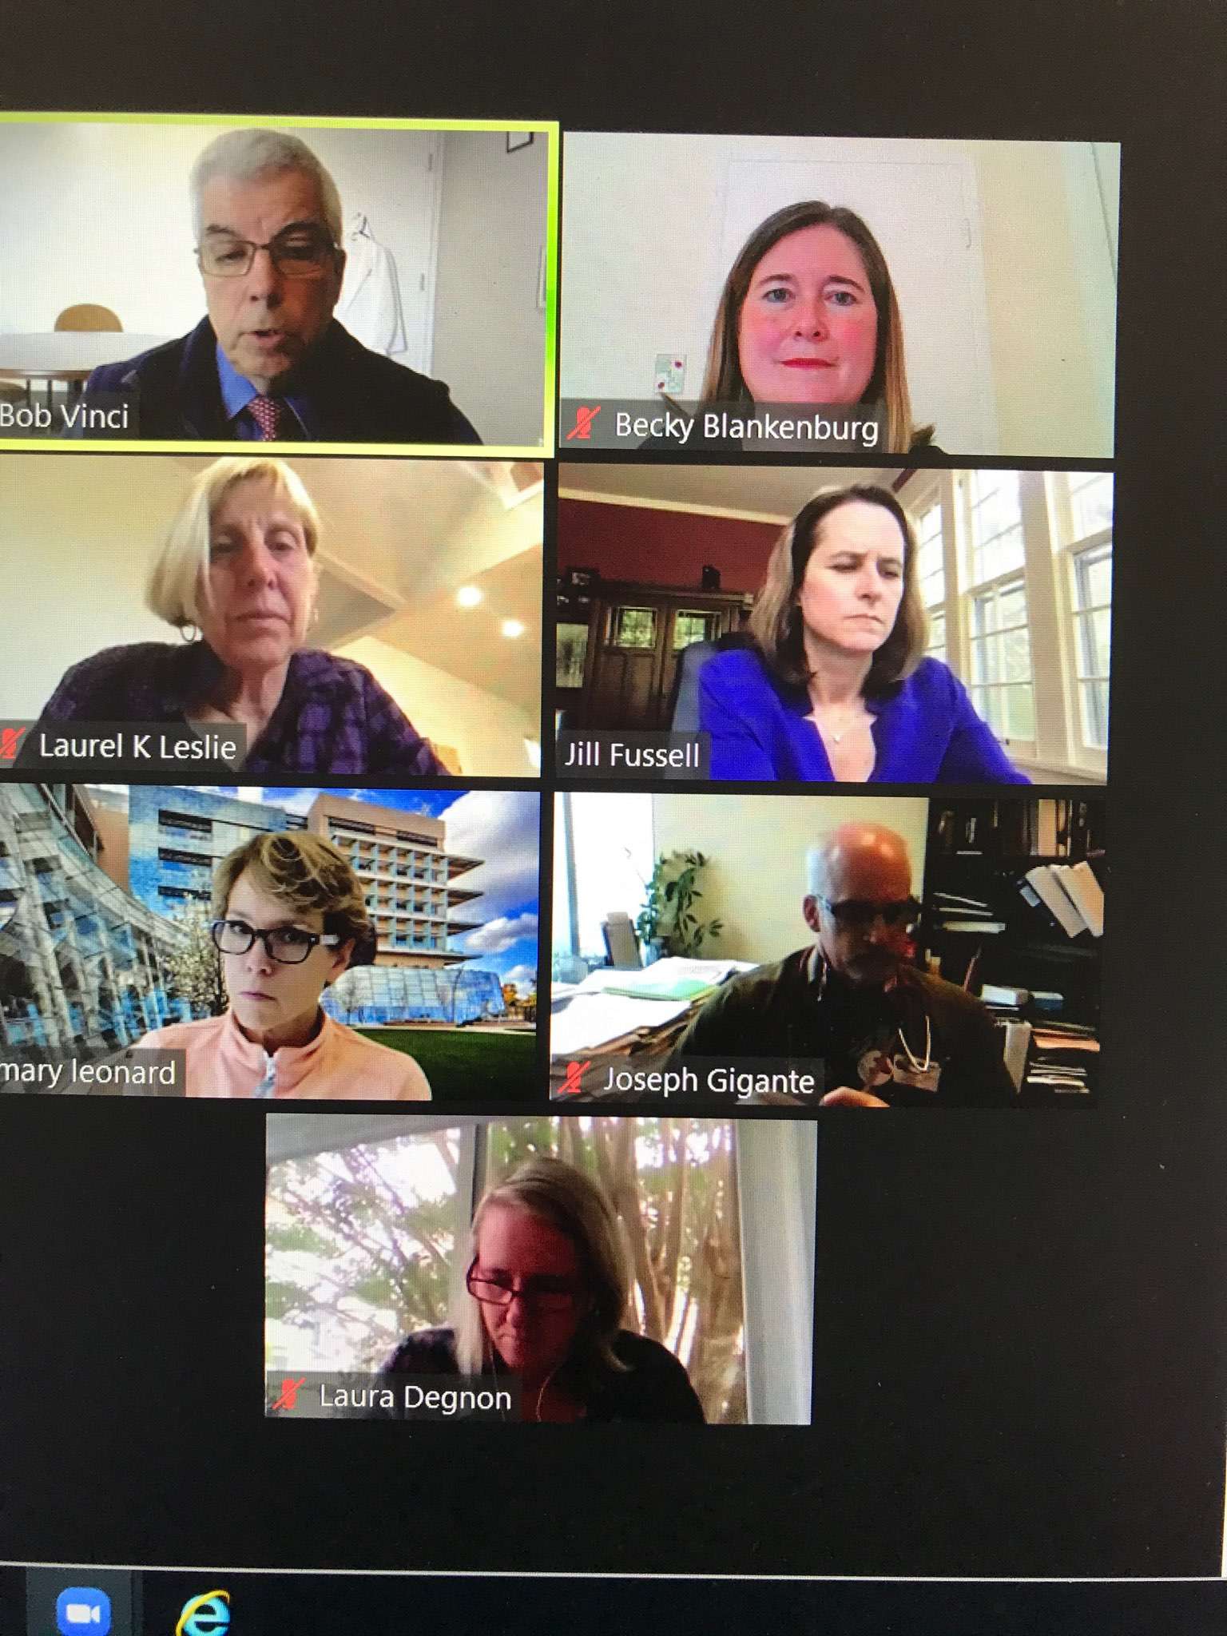
Pediatrics 2025: The AMSPDC Workforce Initiative
Governance
Steering Committee
  Members: Bob Vinci and Laura Degnon (Initiative Co-Leads)
  Becky Blankenburg (Domain 1 Lead)
  Jill Fussell and Laurel Leslie (Domain 2 Leads)
  Mary Leonard (Domain 3 Lead)
  Joe Gigante (Domain 4 Lead)
One of MANY zoom calls of the Steering Committee since February!
@AMSPDC
#Peds2025Workforce

Slide 18

Pediatrics 2025: The AMSPDC Workforce Initiative
Governance
Organizational Representatives Committee
  Purpose: The Organizational Representatives Committee is designed to help ensure the work of the Pediatrics 2025: The AMSPDC Workforce Initiative is a community effort! We seek a minimum of 1-2 representatives of each stakeholder organization.
  Commitment: Representative(s) to serve five years; periodic emails; attend the AMSPDC sponsored workforce summits, ensure your organization is aware of and involved with components of this Initiative that make most sense.
@AMSPDC
#Peds2025Workforce

Slide 19
Organizational Representatives Committee
We Need You!
NextGenPediatricians
#FuturePedsRes
Pediatrics 2025: The AMSPDC Workforce Initiative
@AMSPDC
#Peds2025Workforce

Slide 20
Pediatrics 2025: The AMSPDC Workforce Initiative
Break-Outs
After each Domain Update (20 minutes), we will have 5 minutes for clarifying questions.
We will go into 4 different break-out sessions.
Each break-out session has been assigned a facilitator.
Each break-out session will discuss the domain presented and any specific questions raised by the presenter and/or in the chat. The idea is each break out session discuss the same questions/issues.
Break-outs will last 15 minutes. The facilitator will then present back to the full group – each facilitator will have 1 minute. We ask that each break-out have a scribe and send notes of your break-out to Laura and Bob.
@AMSPDC
#Peds2025Workforce

Slide 21
Pediatrics 2025: The AMSPDC Workforce Initiative
Break-Outs
Thank you to our facilitators:
Group 1: Dr. Leslie Walker-Harding (domains 1 & 2)
Dr. Becky Blankenburg (domains 3 & 4)
Group 2: Dr. John Barnard
Group 3: Dr. Patricia Poitevien
Group 4: Dr. Joseph St. Geme
@AMSPDC
#Peds2025Workforce

Slide 22
AMSPDC Workforce 2025 Initiative Domain 1
Becky Blankenburg, MD, MPH
President, Association of Pediatric Program Directors
October 23, 2020

Slide 23
Domain 1:
Changing the Educational Paradigm, with Impact on Attracting Diverse, High-quality Trainees into Pediatrics and Undersubscribed Pediatric Subspecialties

Slide 24
Excited to Invite Collaborators!

Slide 25
Domain 1a
Curricula: Explore opportunities to redesign our UME and GME learning environments to better position pediatrics as an attractive discipline for trainees, including adopting best practices from allopathic and osteopathic medical schools that have had high pediatric matching rates, creating "fast track" programs that allow for more focused training pathways, and re-examining existing residency program components (length of training, flexibility of inpatient and outpatient training, clinical rotations in subspecialties). Incorporate novel training experiences that better prepares trainees for the patients of today and the future.

Slide 26
Opportunity
Fall 2021 – Pediatrics Review Committee for ACGME will begin to relook at Pediatrics Residency Core Requirements
Can provide helpful, multi-stakeholder perspectives into what the curriculum should look like

Slide 27
Domain 1a
Goal of Training
Needs of Children in 2030-2050 and Models of Care
Stakeholder Perspectives
Curriculum

Slide 28
Domain 1a
Need to conduct a lit review and needs assessment
Examples of current gaps:
Complex care
Behavioral and Mental Health
Social Justice/Equity
Advocacy Skills
Curriculum
Needs of Children in 2030-2050 and Models of Care
Goal of Training
Stakeholder Perspectives

Slide 29
Domain 1a
What is our goal?
General Pediatrician?
Pluripotent Pediatrician?
What do we try to teach in residency/fellowship vs. life-long learning?
Goal of Training
Needs of Children in 2030-2050 and Models of Care
Stakeholder Perspectives
Curriculum

Slide 30
Domain 1a
Parents, Children, Adolescents (diverse)
Community Organizations
Learners (allopathic and osteopathic medical students, residents, fellows with diverse backgrounds and interests)
MPPDA
ACGME
ABP
AAP
COMSEP
AACOM
CoPS
Physician Scientist Group
AMSPDC
APA
Insurance Companies
CHA
Community Pediatricians and Med/Peds
Family Medicine Physicians
Nurse Practitioners/APPs
Experts from other industries (e.g., airlines)
Curriculum
Needs of Children in 2030-2050 and Models of Care
Goal of Training
Stakeholder Perspectives

Slide 31
One Example of Needs Assessment
CoPS Subspecialists Perspectives’ on (pediatric) Training (SPOT) Action Team
Creating a survey for all subspecialties:
  For residents not going into your subspecialty:
    What are the 5 consults you get that you think general pediatricians/other subspecialists should be able to handle?
  For residents going into your subspecialty:
    What you want residents to know when entering your fellowship?

Slide 32
Additional Needs Assessment for Domain 1a
Identify likely model(s) of care (Domain 2)
Explore when residents make decisions on gen peds vs. subspecialty
Explore other training models
  Look at other training (Child Neuro, Accelerated Research Pathway)
Explore 3 tracks (what would they look like? When residents differentiate?)
  Ambulatory gen peds
  Acute care specialties (PHM/PCCM/NICU/PEM)
  Organ based specialties
Explore how Individualized Curricula are currently used

Slide 33
Additional Needs Assessment for Domain 1a
Funding models for UME/GME
Create evaluation metrics that capture patient outcomes (and routinely collect it)

Slide 34
Domain 1b
Advocacy: Engage our regulatory agencies (ACGME, LCME, AACOM) in order to drive change in our educational requirements.

Slide 35
Domain 1c
Subspecialty Exposure: Explore approaches to increase subspecialty exposure early in training (especially in undersubscribed subspecialties), e.g. via models for sharing subspecialty experiences across training programs at different institutions and via increasing interactions between residents and subspecialty fellows.
*Significant overlap between Domains 1c, 1d and 4c, 4d

Slide 36
More Information Needed for Domain 1c (Subspecialty Exposure)
Need to define which subspecialties really are undersubscribed compared with national patient needs of practicing providers (not needs in terms of fellowship spots) (Domain 2)
How do we create a sustainable system of # of fellows and # of providers long-term? (Domain 2)
More current data re:
  When do people make decisions on subspecialty choice (premed? medical school? Early residency?)
  How do people make decisions on subspecialty choice (premed? medical school? Early residency?)

Slide 37
Potential Solutions for Domain 1c (Subspecialty Exposure)
(pre-UME, UME) Increase meaningful exposure to subspecialties in pre-med and medical school
(UME) Share what specialties exist in different residency programs during residency recruitment process
(GME) Early exposure to subspecialties in residency (combination of inpatient and outpatient; can also use virtual and visiting rotations)
(GME) Keep all fellowship matches in the 3rd year
(GME) Create models where residents can stay for fellowship if they do well
(GME) Domain 1b: Work with ACGME/subspecialty societies to not put forward new fellowships/approve fellowship positions/programs if those subspecialties are not needed

Slide 38
Domain 1d
Positive Role Modeling: Develop innovative approaches to enhancing engagement between faculty and trainees by celebrating unique aspects of careers in pediatrics, including science, clinical care (including a broader exposure to clinical activities in a given subspecialty, e.g. outpatient plus inpatient experiences), advocacy, and administration.
*Significant overlap between Domains 1c, 1d and 4c, 4d

Slide 39
Potential Solutions for Domain 1d (Positive Role Modeling)
(pre-UME) Earlier exposure to variety of pediatric fields to balance out the overwhelming focus on adult medicine throughout the 4 years of med school
(pre-UME) Leverage the relationship that children have with their pediatricians as potential career mentors as well as care providers
(pre-UME) Pathway programs to increase elementary school, high school, community college, college -- can do nationally (virtually)
(pre-UME, UME, GME) National campaign to increase the visibility of pediatricians, their varied roles in society and community

Slide 40
Potential Solutions for Domain 1d (Positive Role Modeling)
(UME) Increase exposure to pediatricians in the pre-clinical years (directors, mentors, physical diagnosis)
(UME and GME) Panels of pediatricians from different fields discussing their career paths (Gen Peds, Subspecialties, Researchers, etc) - could consider virtual options
(UME and GME) More exposure needed to pediatric science, research (bench, clinical, pop health, med ed, QI)

Slide 41
Potential Solutions for Domain 1d (Positive Role Modeling)
(GME) A month of shadowing which includes a variety of what they’re interested in: subspecialties of interest, bench research, clinical, etc.
  Time for self-reflection; spend time thinking about themselves and what they want for personal careers.
(GME) Track programs that incorporate significant experiences in underserved communities-spending time with pediatricians practicing in those areas

Slide 42
Excited to Invite Collaborators!

Slide 43
Next Steps
Sub-Action Team 1a (Needs Assessment for Curriculum)
Sub-Action Team 1c/d and 4c/d (Early Exposure and Role Modeling for Pediatrics and Pediatrics Subspecialties)

Slide 44
Small Groups Today
Goal of Training
Are there gaps in the ways we are thinking about the curricular needs assessment?
Who else would you add to the stakeholder list?
Needs of Children in 2030-2050 and Models of Care
Stakeholder Perspectives
Curriculum
Parents, Children, Adolescents (diverse)
Community Organizations
Learners (allopathic and osteopathic medical students, residents, fellows with diverse backgrounds and interests)
MPPDA
ACGME
ABP
AAP
COMSEP
AACOM
CoPS
Physician Scientist Group
AMSPDC
APA
Insurance Companies
CHA
Community Pediatricians and Med/Peds
Family Medicine Physicians
Nurse Practitioners/APPs
Experts from other industries (e.g., airlines)

Slide 45
Report-Outs for Domain 1

Slide 46
Pediatrics 2025: The AMSPDC Workforce Initiative
Domain # 2 Presentation
Laurel Leslie, MD and Jill Fussell, MD
Workforce Data/Needs and Access
@AMSPDC
#Peds2025Workforce

Slide 47











DOMAIN 2:
Pediatric Workforce Network
REPORT
Association of Medical School Pediatric Department Chairs Workforce Initiative
October 23, 2020
Notes:
Deb

Slide 48
Agenda
The Pediatric Workforce Network/Collaborators
Brief Update on Work Accomplished
Key Areas of Focus
Short and Long-Term Goals/Workplan
Examples: 2 Workstreams
Notes:
Deb

Slide 49
ThE PEDIATRIC WORKFORCE NETWORK
Jointly launched by ABP and CoPS in Fall 2018
Focused on identifying critical questions and summarizing data to answer questions about the current and future pediatric subspecialty workforce
Natural fit for Domain 2
Notes:
Deb will cover; logos here?

Slide 50
DOMAIN 2: Data/Needs and Access
  Data
    Understanding recent trends in pediatric workforce. by analyzing data
      Workforce diversity
      Physician scientists
      DOs
      Work profiles (clinical, teaching, research, other activity) of our pediatric subspecialists
      Advanced practitioners (PA’s and NP’s)
  Needs and Access
    Partner with appropriate organizations to understand workforce challenges
      Access
      Regionalization of care
      Distribution of workforce
      Care model changes (APP’s, Psychologists, Social workers)
      Changes in referral patterns
      Impact of other components of the workforce (DO’s)
Notes:
Jill

Slide 51
Work Accomplished
Hosted multiple network meetings
  Building infrastructure
  Identifying/sharing data sources
Presented to Council of Pediatric Subspecialties (CoPS) and the ABP Foundation Board of Directors
Established workstreams
  Identified leads/collaborators
  Conducted preliminary analyses and drafted manuscripts for 2 workstreams
Notes:
Jill

Slide 52
KEY AREAS OF FOCUS:
ACTIVE WorkSTreams
Osteopathic Medical School Graduates in the Pediatric Workforce
Physician Scientist
International Medical School Graduates (IMGs) in the Pediatric Workforce
ABP Foundation-funded Pediatric Subspecialty Supply Workforce Modeling Project (UNC-Sheps)
Notes:
Laurel

Slide 53
KEY AREAS OF FOCUS:
Workstreams just launching
Data --- still need to figure out where to put APP/NPs
Racial/ethnic Diversity in the Pediatric Workforce
Advanced practice providers (APPs)
  Data complex for nurse practitioners
  while a smaller portion of the pediatric workforce, data on physician assistants becoming available
Profiles of Subspecialists, including Practice Patterns, Job Availability, and Team-Based Care
Notes:
Add NP and PA here?
(NAPNAP presentation)- opportunities for a paper together
Laurel

Slide 54
SHORT- and Long-Term Goals
Short-term: Support existing workstreams
Long-term: Address other areas of domain
    Access
    Regionalization of care
    Care model changes (APP’s, psychologists, social workers)
    Changes in referral patterns
    Not on the initial list: Consider impact of Covid-19 and systemic racism on the above
Notes:
Laurel

Slide 55
PEDIATRICIAN SCIENTIST
Stephanie Davis, MD
October 23, 2020

Slide 56
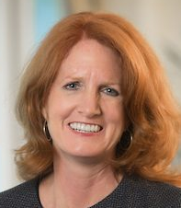
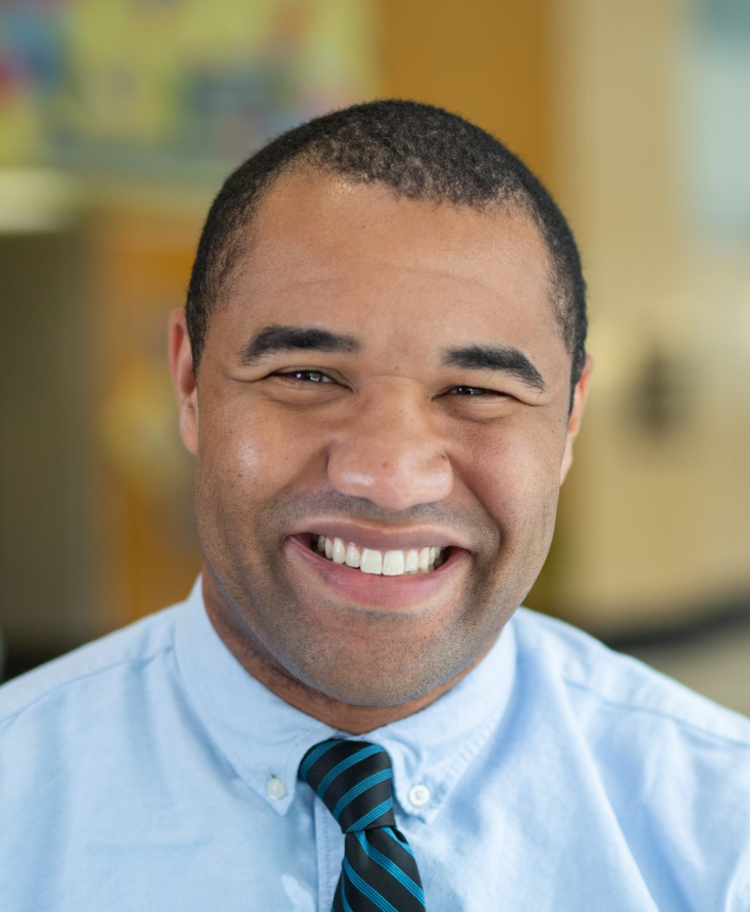
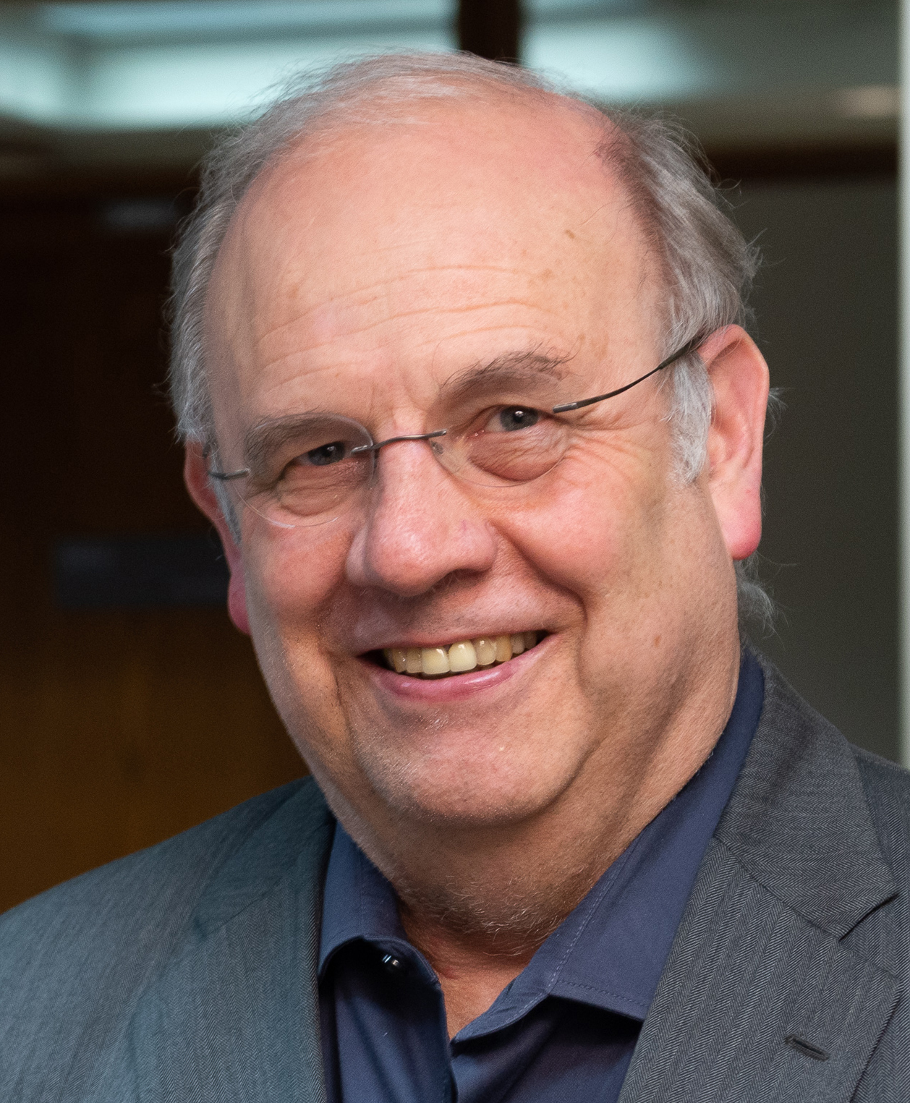
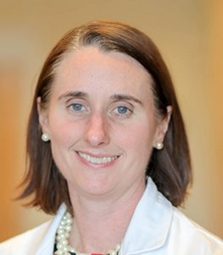
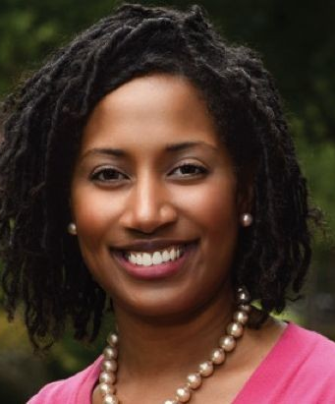

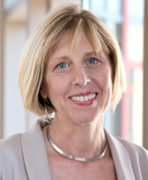
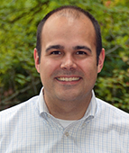
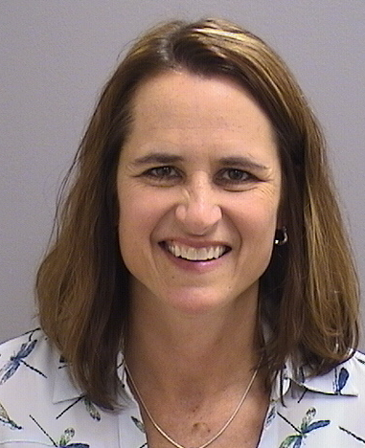
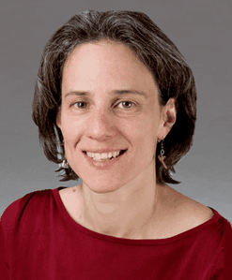
Contributors
Stephanie Davis
Colin Orr
Wade Clapp
Sallie Permar
Audrea Burns
Bob Vinci
Laurel Leslie
Adam Turner
Jill Fussell
Debra Boyer

Slide 57
Ongoing Activities
Evaluate Existing Physician Scientist Pathways/Pipelines
  What are their Outcomes?
Future Plans

Slide 58
Current Pathways/Pipelines
Accelerated Research and Integrated Research Pathways (ABP)
NICHD-funded Physician Scientist Development Pathway
Frontiers in Science
National Physician Scientist Collaborative
NIH StaRR Program
MD/PhD Programs
Fellowship Programs
APA Research Training
RAPID – Research in Academic Pediatrics Initiative
New Century Scholars

Slide 59
ABP Research Pathways
Accelerated (ARP)
2yrs GP then subspecialty
Fellowship 4yrs
No specific eligibility criteria
Does Not need ABP approval
Notify ABP end PGY 1
Eligible for GP exam after 2yrs GP + 1yr sub clinical time
Integrated (IRP)
3yrs GP then subspecialty
Fellowship 3yrs
Specific eligibility criteria
Needs ABP/CC approval
Apply by end of PGY 1
Eligible for GP exam after 3yrs GP + 1yr sub (6mo clinical)

Slide 60
ABP Research Pathways
Accelerated (ARP)
Cannot fast-track
Data 2003 – present
26 Programs
~100 Trainees
  86 in progress/completed
  14 discontinued
Integrated (IRP)
May be eligible to fast-track
Data 2001 – present
35 Programs
~184 Requests
  154 approved trainees
  29 disapproved/discontinued

Slide 61
NIH StARR Program
Stimulating Access to Research in Residency:
  Institutional programs supporting 80% PGY
  2-4 residents/year – each supported 1-2 years as resident-investigators
  Goal: help provide a continuum of research opportunities throughout clinical training
  Required:
    Letter of support from the appropriate ABMS Board
    Proposed structure must lead to board eligibility of participants
  Status: ABP letters of support > 30

Slide 62
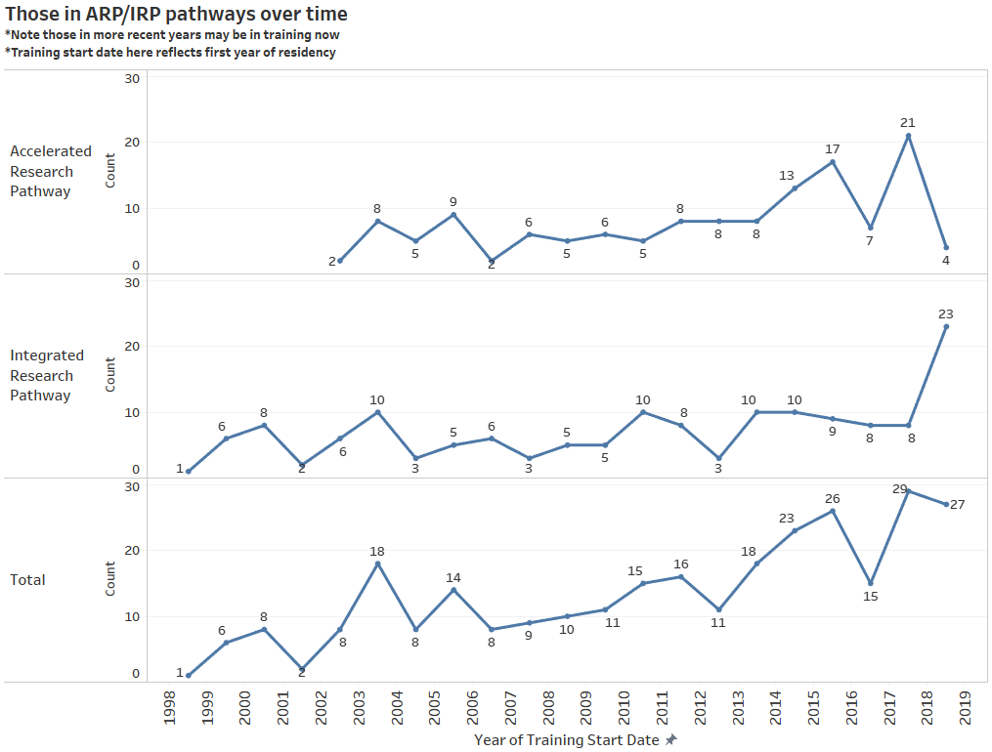
~284 since inception
<1% of the workforce

Slide 63
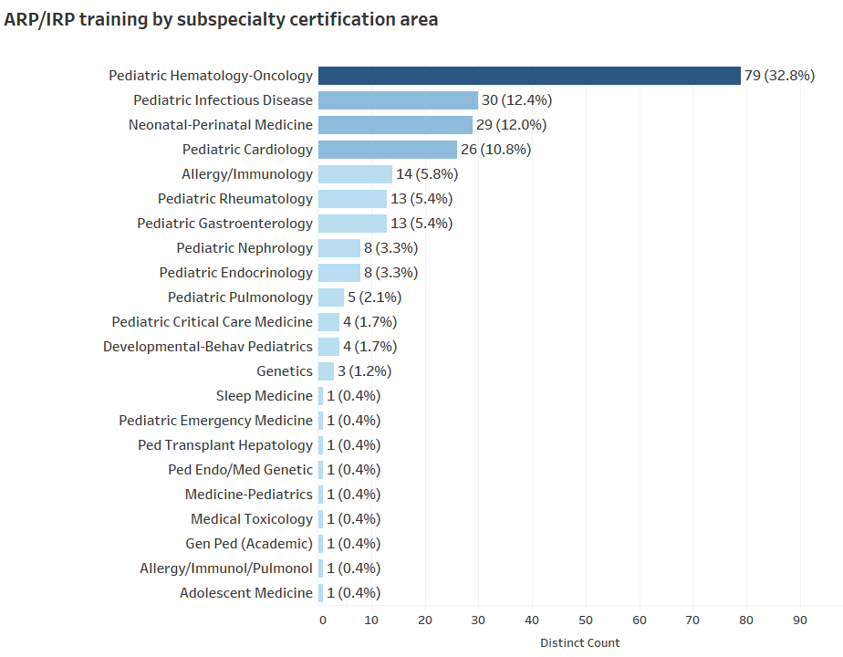
ARP/IRP subspecialty areas based on those completed or those who have progressed to fellowship
*Few have specialized in more than one area (~4)
** Those in residency now are not shown here

Slide 64
Pediatric Scientist Development Program (PSPD)
Mission: To develop the next generation of diverse pediatrician-scientist leaders through exceptional research training and a robust, multilevel mentorship environment
Goals
  Research training for subspecialty pediatrics
  Address problems central to child health
  Combat the declining number of trained pediatric physicians who go to become independent scientist
  2-3 years of mentored research training for subspecialty pediatric fellows with >90% protect research time

Slide 65
PSDP Outcomes

Slide 66
ROI >14

Slide 67
Frontiers in Science: PSDP Pipeline
Goal: Increase the number and diversity of pediatric residents pursing fellowship and PSDP training
Interventions
  Provide FIS residents with PSDP alumni mentor
  Direct emails to 2018-2019 FIS residents with PSDP application
  Presentation at APPD
  Target geographic locations with application pool is low

Slide 68
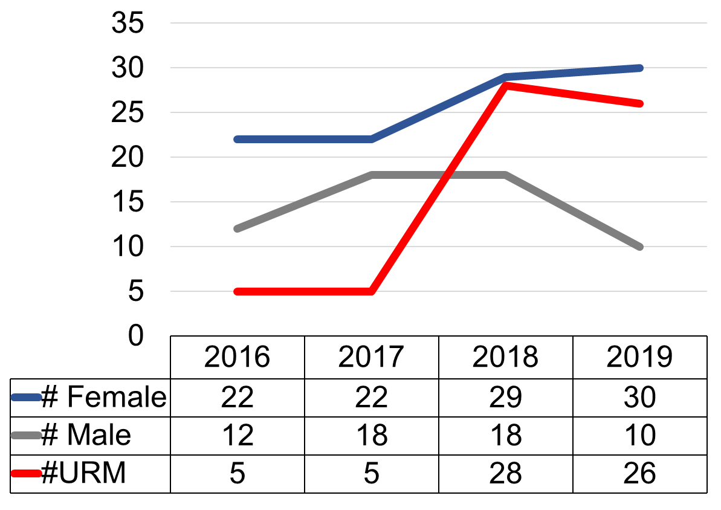
Diversity in Frontiers in Science
Special call for URiM applicants in 2018
Call led to increase in diversity
  65% of FIS attendees identified as URiM
  75% were female

Slide 69
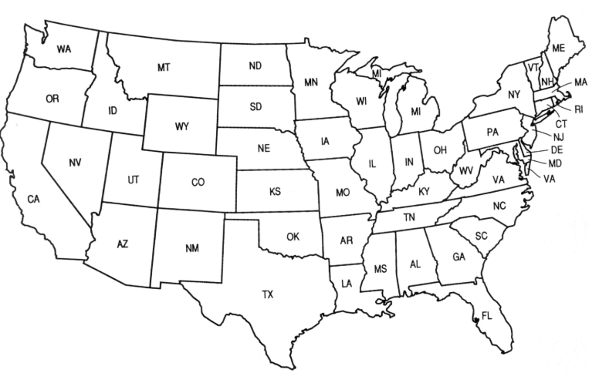
Increasing Geographic Diversity in FIS
Female
Male

Slide 70

National Pediatrician-Scientist Collaborative Workgroup
(NPSCW)
Kate Ackerman, MD and Audrea Burns, PhD
Association of Medical School Pediatric Department Chairs
Summit
Friday, October 23, 2020

Slide 71
Mission & Vision
Mission
  Foster the sustainability and success of pediatrician-scientist development and training in residency and advocating for strengthening the pipeline to advance improvement and innovation of global child health
Vision
  Identify and disseminate best practices for training pediatrician-scientists in residency
  Develop metrics for training pathway selection
  Incorporate sustainable models for recruitment and support of pediatrician-scientist trainees from underrepresented backgrounds

Slide 72
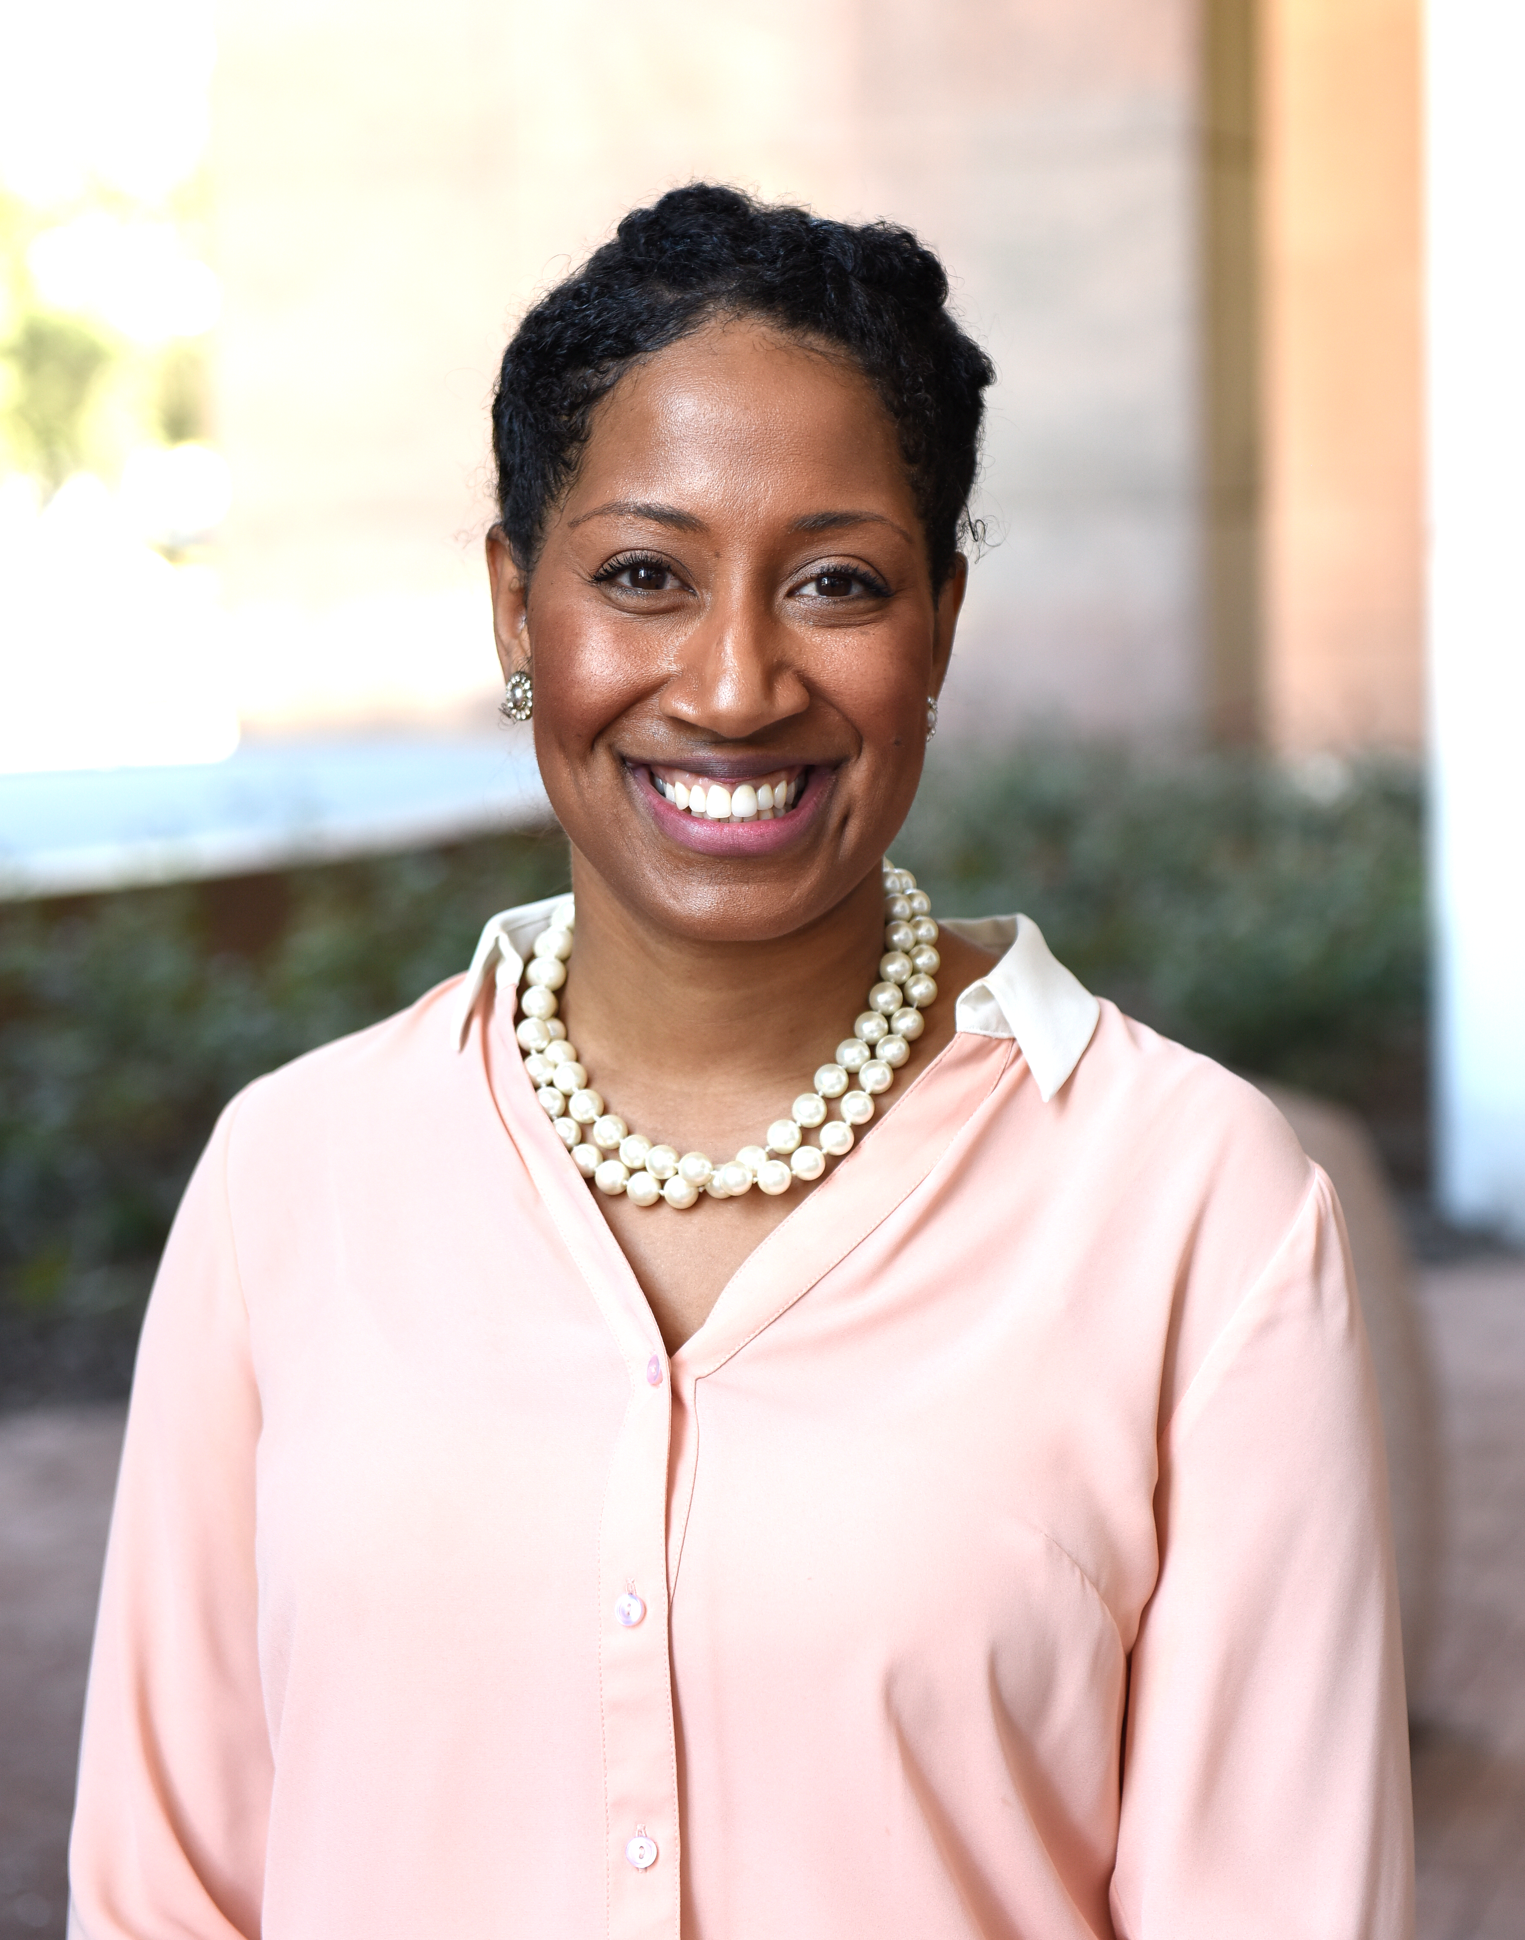
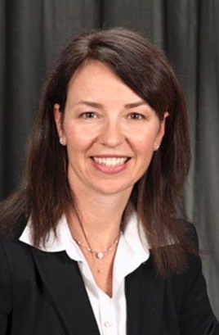
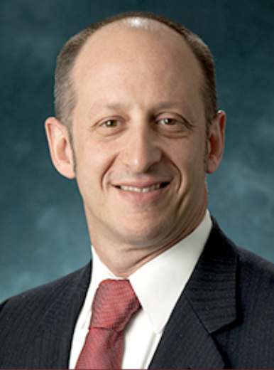
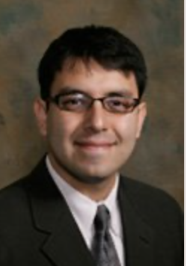
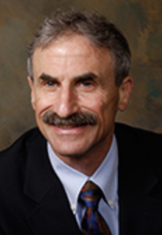
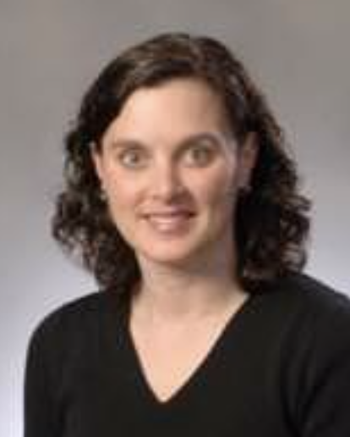
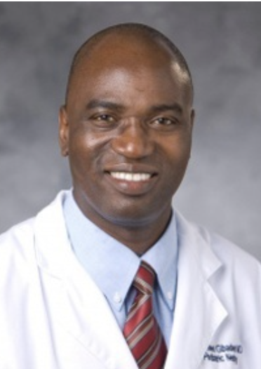


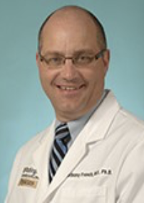
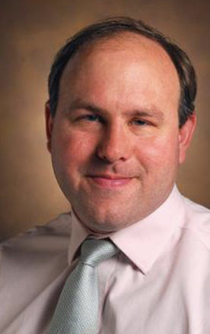
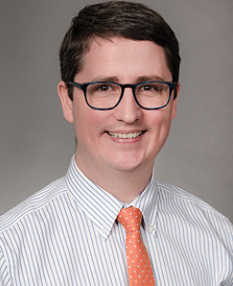
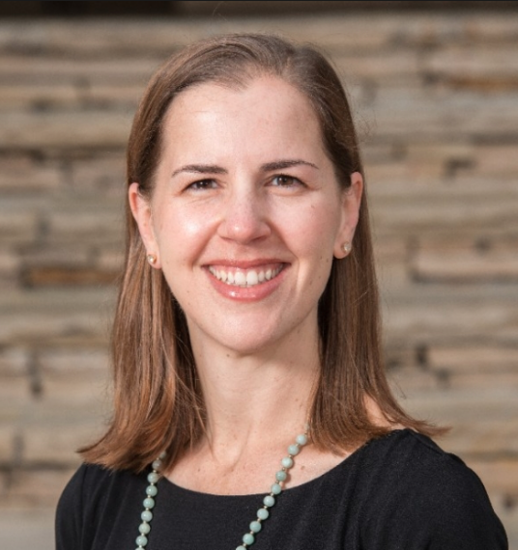




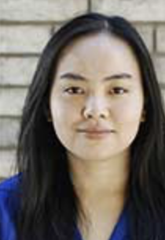
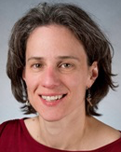
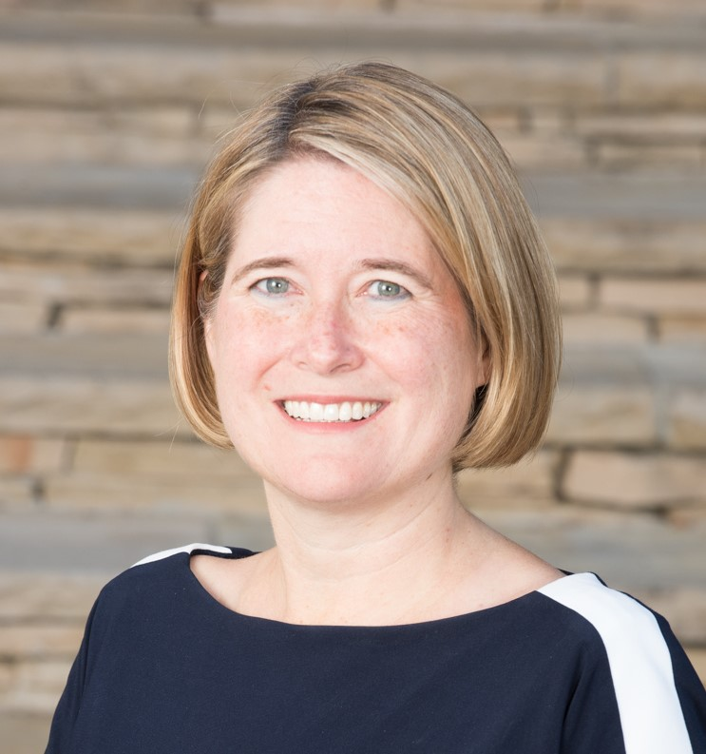
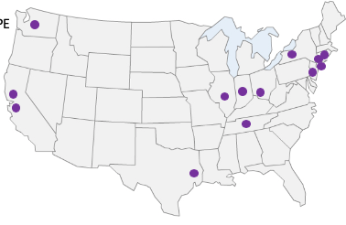
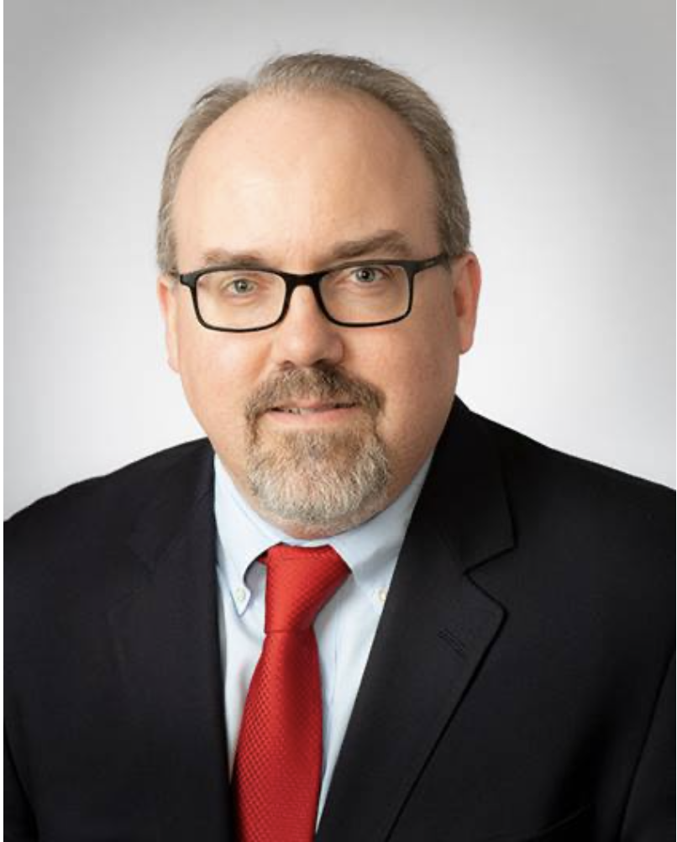
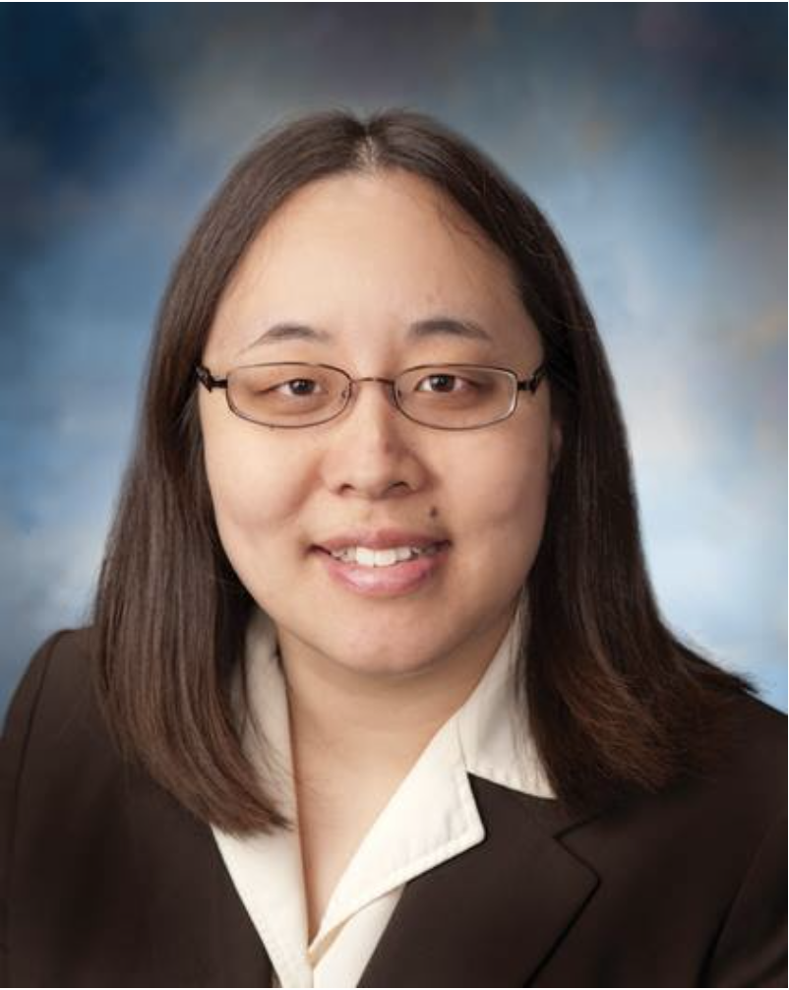
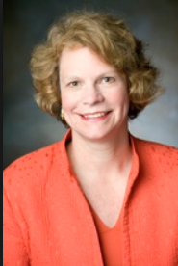
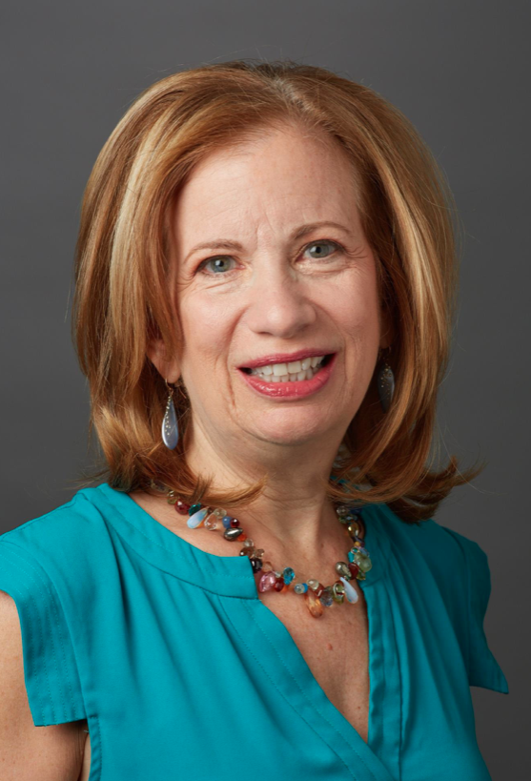
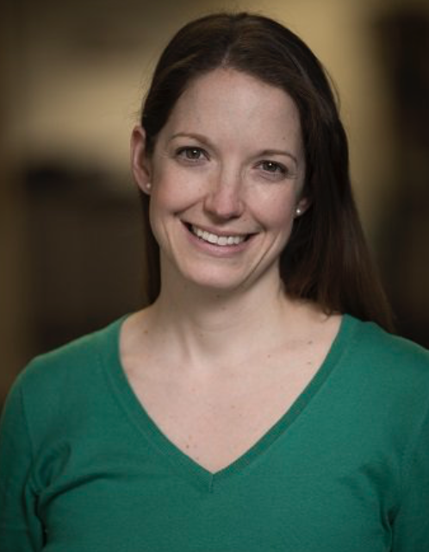
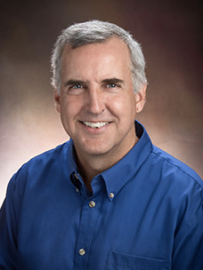
Audrea Burns PhD
Texas Children’s
Katie Ackerman MD
Golisano Children’s
Jordan Orange MD, PhD
Morgan Stanley
Fernando Gonzalez MD,
Benioff Children’s
Mel Heyman MD
Benioff Children’s
Bobbi Byrne MD
Riley Hospital for Children
Rasheed Gbadegesin, MD, MBBS
Duke Children’s Hosp.
Heather McPhillips MD
Seattle Children’s
Tara Wenger MD, PhD
Seattle Children’s Hospital
Tony French MD, PhD
St. Louis Children’s Hospital
Daniel Moore MD, PhD
Monroe Carell Jr. Children’s
Weston Powell MD, PhD
Seattle Children’s
Carrie Rassbach MD
Stanford Children’s
Katie Barrett, MA
Duke Children’s Hosp.
Mark Ward MD
Texas Children’s Hospital
Will Parsons MD, PhD
Texas Children’s Hosp.
Satid Thammasitboon MD
Texas Children’s Hosp.
Suong Nguyen MD, PhD
St. Louis Children’s Hospital
Debra Boyer MD, MHPE
Boston Children’s Hosp.
Rebecca Blankenburg MD, MPH
Stanford Children’s
Andrew Nowalk MD, PhD
Children’s Hosp. of Pittsburgh
Jacqueline Ho, MD
Children’s Hosp. of Pittsburgh
Margaret Hostetter MD
Cincinnati Children’s Hosp.
Pnina Weiss MD
Yale-New Haven Children’s
Katie Forster MD, MS
Children’s National
Michael Hogarty MD, PhD
Children’s Hosp. of Philadelphia
Notes:
Kate Ackerman

Slide 73
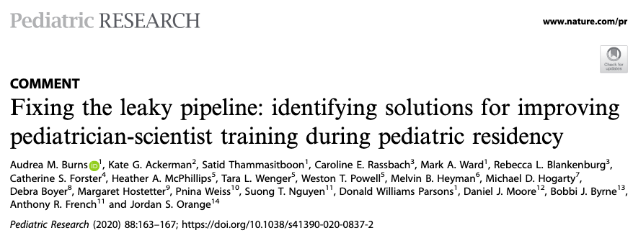
Current Strategic Focus
Understanding structure of pediatrician physician-scientist training at ACGME accredited residency training programs- survey of pediatric program directors

Slide 74
Academic Pediatric Association Research Training Programs
Data from these programs could help inform approaches in to increase racial/ethnic diversity of researchers
APA Research Training Programs
  APA Young Investigator Award
    Provides $10-15,000 dollars for fellows/junior faculty research projects
    Provides at least one award to an individual who identifies as a URiM
  Research in Academic Pediatrics Initiative on Diversity (RAPID)
    Funded by NIDDK (R25DK096944)
    Provides mentorship and funding for URiM disadvantaged researchers
  New Century Scholars Programs
    Targets URiM residents with an interested in research/academic medicine

Slide 75
Future Plans
Evaluating Outcomes
  Grants
  Publications
  Mentorships
  -pubmed and/or CV review?
White Papers – where we are, where we need to go
  Currently developing paper to highlight outcomes of ABP research pathways

Slide 76
Preliminary Analysis:
Contribution of
Osteopathic Medical School Graduates to the Pediatric Workforce
John Barnard, MD
October 23, 2020

Slide 77
The Osteopathic Profession

Slide 78
Doctor of Osteopathy
MDs practice allopathic medicine, the classical form of medicine, focused on diagnosing and treating human diseases.
DOs practice osteopathic medicine, which views the patient more holistically to reach a diagnosis, rather than treating symptoms alone.
A DO
  Has equivalent rights, privileges, and responsibilities as a physician who has earned the Doctor of Medicine (MD) degree.
  May practice in all 50 states
  Has unlimited practice rights in ~ 74 countries
  Constitute 11% of all US physicians
The AMA has a representative of the American Osteopathic Association as a member in the AMA legislative body, the House of Delegates.

Slide 79
Osteopathic Medical Schools

Slide 80
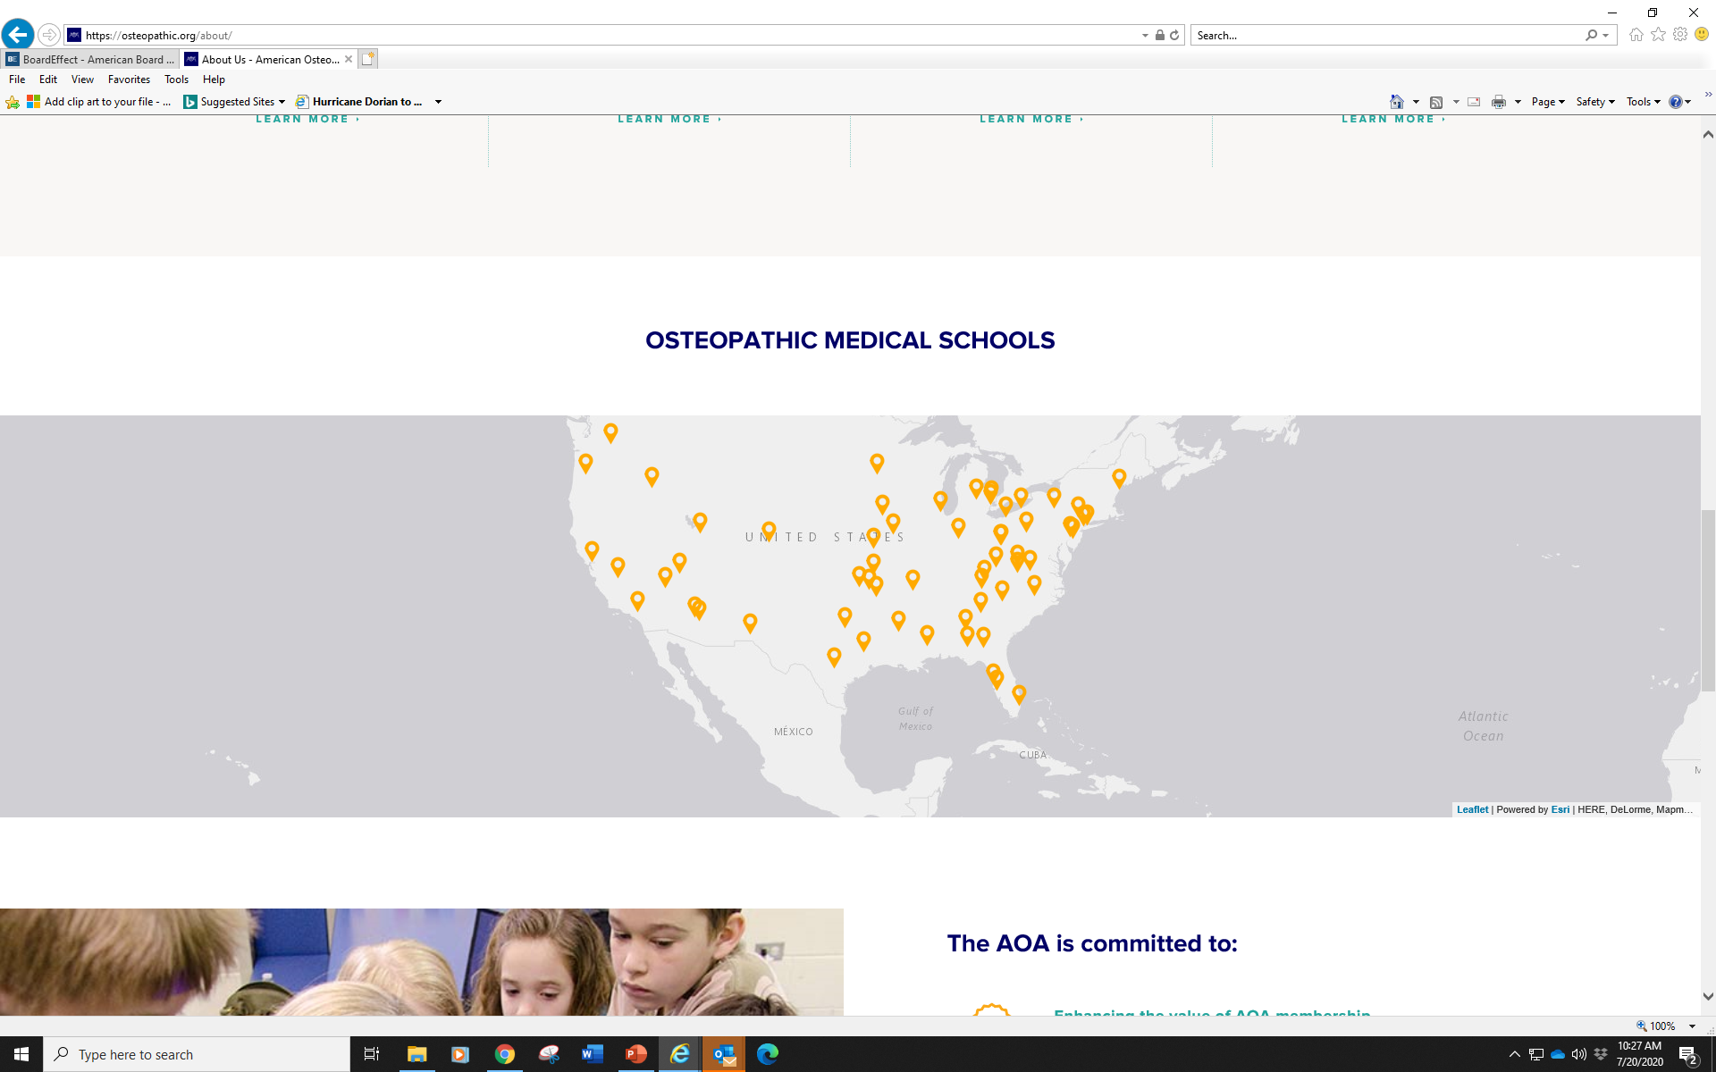
Osteopathic Medical Schools Are Nationwide
37 osteopathic medical schools offering instruction at 58 teaching locations

Slide 81
U.S. Osteopathic Medical School Enrollment
3X Growth
American Association of Colleges of Osteopathic Medicine (AACOM) data

Slide 82
DOs are 25% of US Medical Student Population
11% of all
medical doctors are DOs

Slide 83
DOs and Pediatric Residency

Slide 84
Pediatric Residency Matriculants by Degree
22%
78%

Slide 85
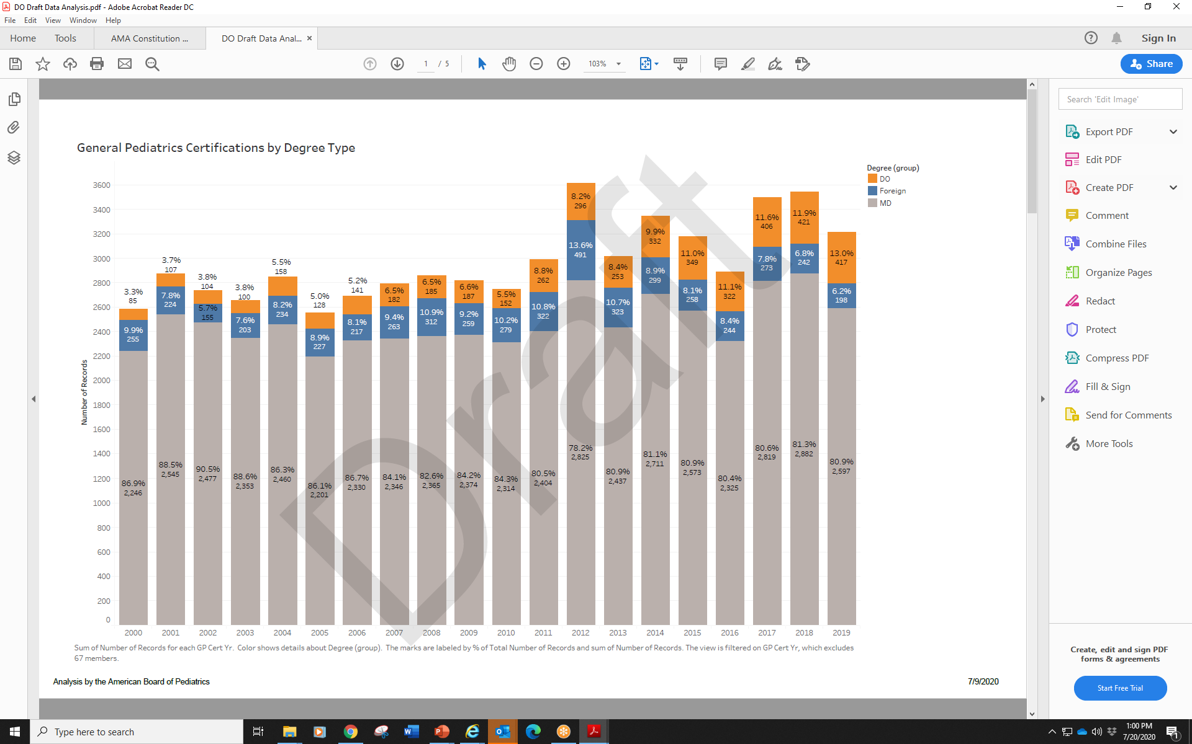
% DO General Pediatrics Certificates is Increasing

Slide 86
DOs and Pediatric Subspecialties

Slide 87
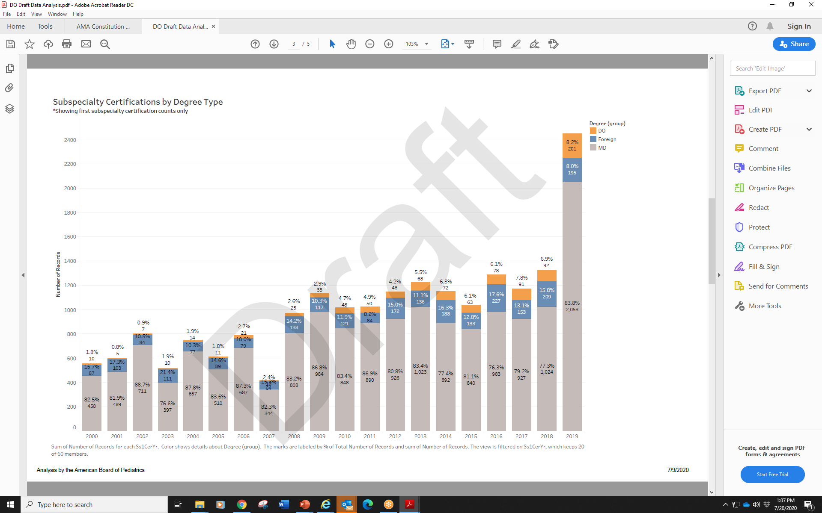
% DO Subspecialty Certificates is Increasing

Slide 88
Growth of DOs in Pediatric Board Certificates
DRAFT ABP Data: Summer 2020

Slide 89
CONCLUSIONS
The “boundary” between DO and MD physicians is increasingly gray
Osteopathic medical schools and their graduates are increasing in number and are a significant factor in pediatric workforce calculations
DOs are an increasing percentage of
  Pediatric residencies
  Pediatric subspecialty fellows
  ABP certified general pediatricians
  ABP certified subspecialists

Slide 90
Discussion
Other Data Sources?
Additional Partners?
Thinking about tackling Needs and Access Section…
Creative Models of Care?
Identify Best Practices to Improve Access?

Slide 91
APPDENDIX

Slide 92
International MEDICAL GRADUATES
Data from the AAP’s Research Department and the Section on International Medical Graduates

Slide 93
RECAP: What do we know about pediatricians who are IMGs?
1. Key component of AAP & US pediatric workforce
2. Important component of underrepresented minorities
3. Older at pediatric residency
4. Recent graduates more likely to go to underserved areas
5. Graduates more likely to go to fellowship training

Slide 94
RECAP: What do we know about pediatricians who are IMGs?6
6. Earn similar salaries
7. Less likely to have educational debt
8. Job Search differences
9. More likely to have global health plans
10. Satisfaction & mentorship: similar and different

Slide 95
% of Graduating Residents Reporting Difficulty in Job Search
(Among Residents Who Applied for Primary Care Jobs)
18%
32%
Source: AAP Annual Survey of Graduating Residency, 2014-2018; n=999
Average age=31 years; IMG: Graduated from a medical school outside the US or Canada
Notes:
NOTE: Significant difference, p<.001

Slide 96
Percent of Graduating Pediatric Residents Reporting
Job Obtained in Same State as Residency
(Among Residents Who Applied for Primary Care Jobs)
Source: AAP Annual Survey of Graduating Residency, 2014-2018; n=972
Average age=31 years; IMG: Graduated from a medical school outside the US or Canada
Notes:
NOTE: Significant difference, p<.001

Slide 97
Factors Important in Job Selection All Residents
Percent of Graduating Pediatric Residents Reporting Essential or Very Important
Source: AAP Graduating Resident Survey, 2014-2018; n=2646
Notes:
NOTE: Significant differences for all, p<.01

Slide 98
Percent of Early and Midcareer Pediatricians
Satisfied with Their Job, Career as a Physician, and Salary
Source: AAP PLACES Annual Survey, 2015 (weighted data; n=1376); Katakam et al, 2019
Average age=40 years; IMG: Graduated from a medical school outside the US and Canada and grew up outside the US
Notes:
NOTE: Job and career satisfaction: satisfied is % strongly agree or agree; for salary: satisfied is % Completely or Very satisfied.
Job is rewarding: 30% of USMG and 17% of IMG strongly agree. Satisfied with career as a physician: 24% of USMG and 19%

Slide 99
Physician Mentor to Turn to for Support
Percent of Graduating 2012 Pediatric Residents Reporting “Yes”
“Is there a physician who you consider a mentor and you can turn to for support on the following topics?”
Source: AAP Graduating Resident Survey, 2012; n=608

Slide 100
Advanced Practice
Provider Information

Slide 101
PREVIOUS RESEARCH IN 2011
For subspecialists overall, 69% had a PA or NP in their practice. Of those:
  96% reported that there were NPs in their practices
  32% reported that their practices included PAs. There was very little variation among the subspecialties
43% subspecialists who worked with NPs or PAs reported their practices plan to increase the number of NPs in the next 5 years
  25% indicated that their practices would expand the scope of work
  29% of respondents reported that the number of NPs in their practices likely would remain the same.
Source: Gary Freed, et al. Pediatrics. 2011. Nurse Practitioners and Physician Assistants Employed by General and Subspecialty Pediatricians

Slide 102
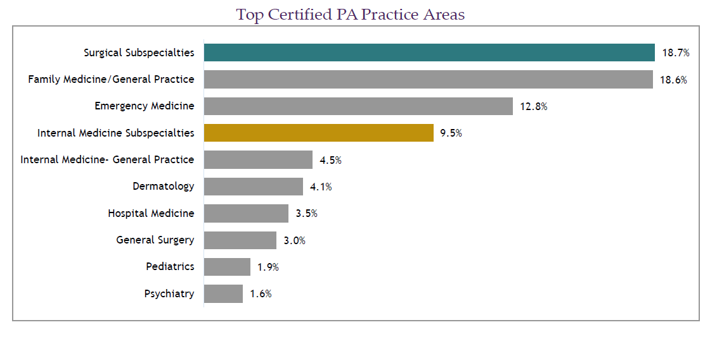

25.0% of certified PAs work in primary care: family medicine/general practice, general internal medicine, and general pediatrics. The percentage of certified PAs practicing primary care has decreased in the past five years. In 2013, 27.7% of Certified PAs reported they worked in a primary care specialty.
Source: 2019 Statistical Profile of Certified Physician Assistants ©NCCPA 2020. All rights reserved.
Notes:
2019 Statistical Profile of Certified Physician Assistants ©NCCPA 2020. All rights reserved.

Slide 103
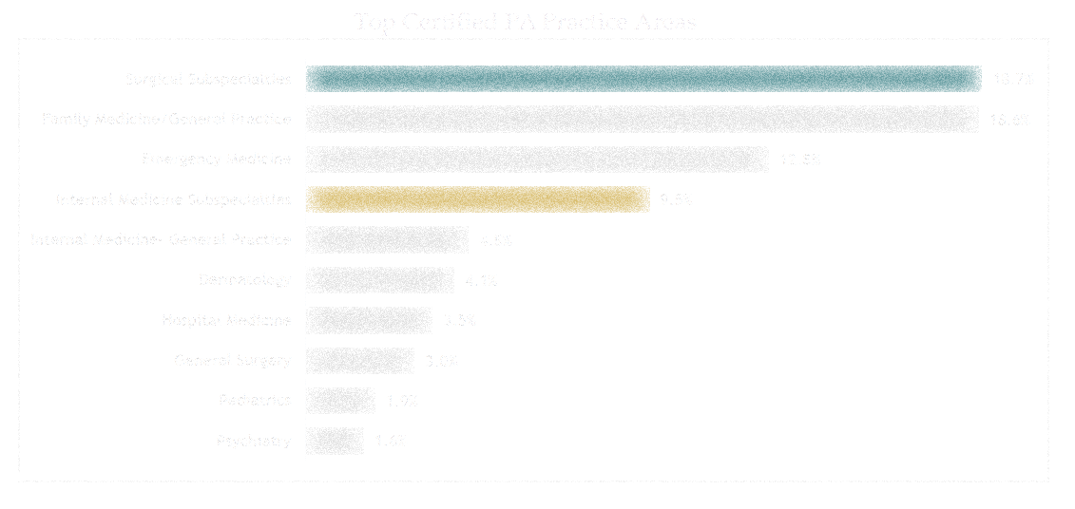
Physician Assistants Numbers
Number Practicing (% - of PA population)
Pediatrics- General Practice 1,979 1.9%
Pediatrics– Subspecialties 1,322 1.3%
Salary/Income (From Last Calendar Year)
# Included Mean Median
Pediatrics– General 1,878 $94,526 $95,000
Pediatric- Subspecialties 1,270 $107,110 $105,000
Source: 2019 Statistical Profile of Certified Physician Assistants ©NCCPA 2020. All rights reserved.
Notes:
The average salary of certified PAs was $113,186 and the median salarywas $105,000 with the highest paid to those working in dermatology andcritical care medicine. The average salary has increased 15.0% in the last six years.

Slide 104
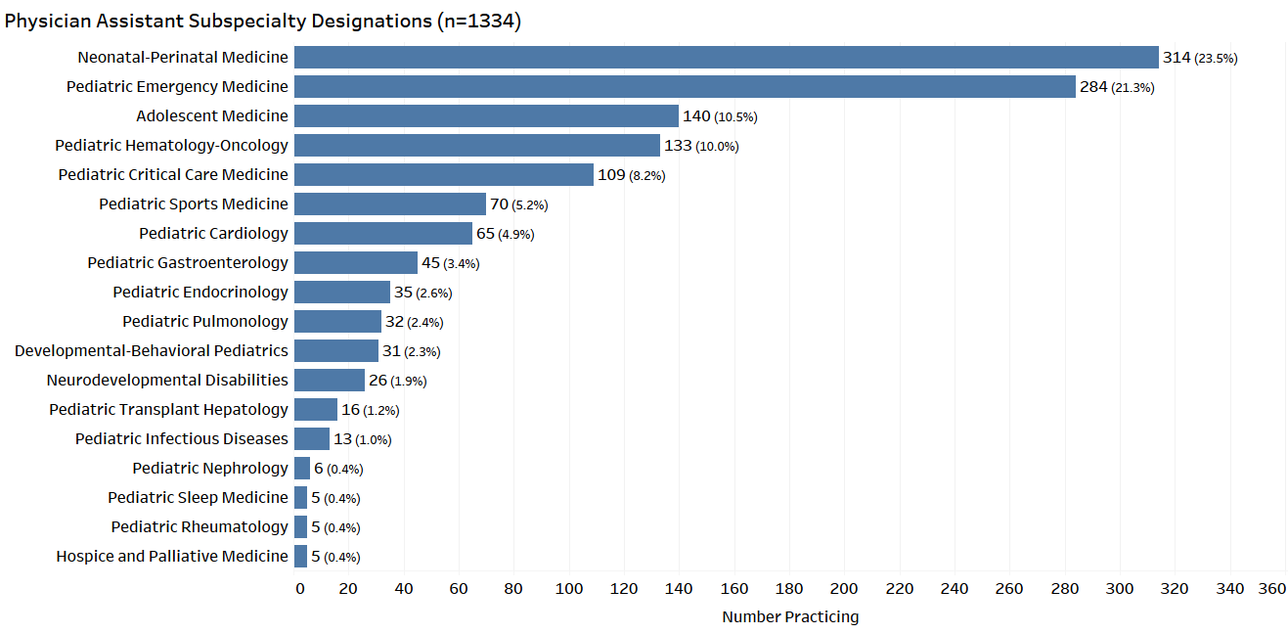
2018 Specialty Report © NCCPA 2019. All rights reserved.

Slide 105
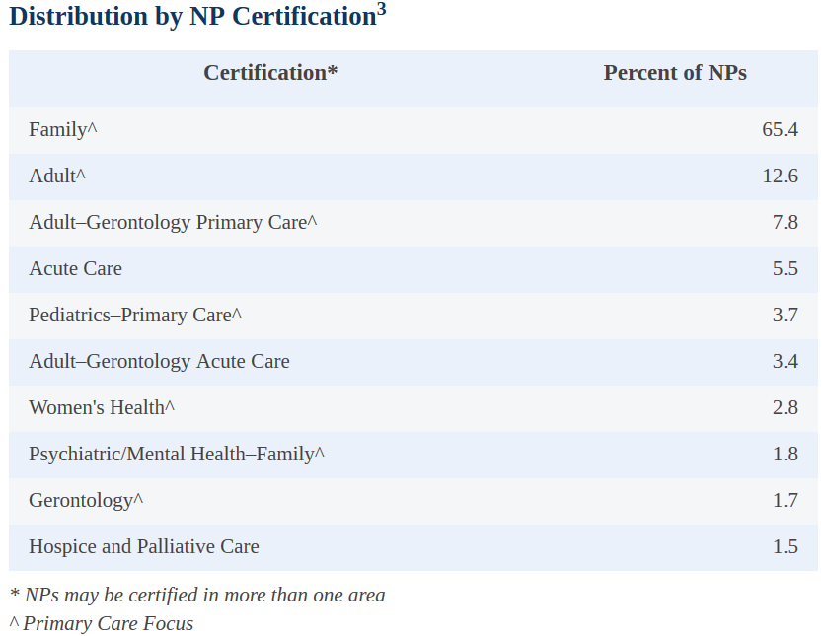

There are more than 290,000 nurse practitioners (NPs) licensed in the U.S.
More than 28,700 new NPs completed their academic programs in 2017–2018.
89.7% of NPs are certified in an area of primary care, and 69.0% of all NPs deliver primary care.
In 2019, the median base salary for full-time NPs was $110,000.
Source: https://www.aanp.org/about/all-about-nps/np-fact-sheet
Updated February 2020
Notes:
10,730 with Primary Care Pediatric Certification

Slide 106
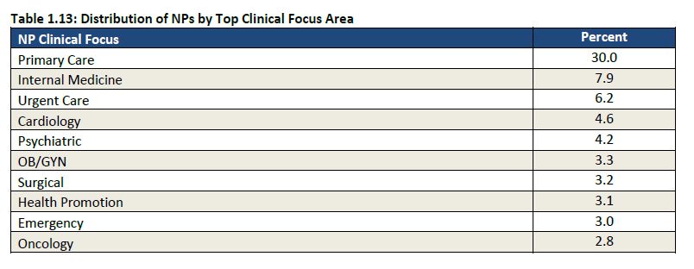
NP Clinical Focus Areas – Top 10
Source: 2018 AANP National NP Sample Survey: Practice

Slide 107
Pediatrics 2025:
The AMSPDC Workforce Initiative
October 23, 2020
Break
We will begin again at 3:35pm
@AMSPDC
#Peds2025Workforce

Slide 108

Pediatrics Workforce 2025 Initiative
Domain #3: Economic Strategy
Mary B. Leonard, MD, MSCE
Arline and Pete Harman Professor and Chair, Department of Pediatrics
Stanford School of Medicine
Adalyn Jay Physician-n-Chief, Lucile Packard Children's Hospital
Director, Stanford Maternal and Child Health Research Institute

Slide 109



Acknowledgements
AAP Leadership
  Mark Del Monte, CEO/Executive Vice-President
  Ann Edwards, AAP Chief Population Officer
AAP Committee on Pediatric Workforce
  Lauren Barrone, AAP Senior Manager, Pediatric Practice and Workforce
  Harold K. Simon, Chair, Committee on Pediatric Workforce
Pediatric Policy Council
  James Baumberger, AAP Senior Director, Federal Advocacy
  Matthew Mariani, AAP Policy Associate
  Shetal Shah, SPR Representative
  Michael Artman, AMSPDC Representative
Children’s Hospital Association
  Amy Knight, COO
  Amanda Major, Manager, Federal Affairs

Slide 110
Economic Strategy Topic Areas
Financial Burden
  Target new strategies to minimize debt burden
Compensation and Revenue Stream
  Develop strategies to achieve greater parity with adult providers and greater parity among procedural and non-procedural pediatric subspecialists
Children’s Hospital GME
  Develop strategies to achieve parity with Medicare GME

Slide 111
Economic Strategy Topic Areas
Financial Burden
  Target new strategies to minimize debt burden
Compensation and Revenue Stream
  Develop strategies to achieve greater parity with adult providers and greater parity among procedural and non-procedural pediatric subspecialists
Children’s Hospital GME
  Develop strategies to achieve parity with Medicare GME

Slide 112
Strategies to Minimize Debt Burden
Pediatric Subspecialty Loan Repayment Program
  Congress reauthorized the PSLRP for five years. The Academy is urging Congress to provide $50 million in funding for the program for fiscal year 2021.
  The program would provide up to $35,000 annually for a maximum of three years to pediatric subspecialists who agree to practice in an underserved area.
Title VII Health Professions Workforce Development Programs
  Faculty Loan Repayment for racial and ethnic minority medical school faculty
  Scholarships for Disadvantaged Students

Slide 113
Strategies to Minimize Debt Burden
Rochlin & Simon. Does Fellowship Pay: What is the Long-term Financial Impact of Subspecialty Training in Pediatrics? Pediatrics 2011.

Slide 114
Economic Strategy Topic Areas
Financial Burden
  Target new strategies to minimize debt burden
Compensation and Revenue Stream
  Develop strategies to achieve greater parity with adult providers and greater parity among procedural and non-procedural pediatric subspecialists
Children’s Hospital GME
  Develop strategies to achieve parity with Medicare GME

Slide 115
% Difference: Adult vs Pediatrics
Median Total Compensation ($,000)

Slide 116
% Difference: Adult vs Pediatrics
Median Total Compensation ($,000)

Slide 117
% Difference: Adult vs Pediatrics
Median Total Compensation ($,000)

Slide 118
Children’s Health Insurance
Medicaid is the single largest insurer of children.
Medicaid, with CHIP, covers 48% of all US children.
Of all Medicaid enrollees, nearly half are children.
Medicaid has historically paid physicians lower fees than Medicare for the same services.
  hovering ~ 70% of Medicare fees, on average, and ~ 64% for pediatric primary care
The Affordable Care Act included a mandatory two year increase in fees for primary care to Medicare levels for Medicaid fee-for-service and managed care in 2013 and 2014.
Federal lawmakers did not reauthorize funding for the increased payments to primary care services, ending the fee bump in December 2014.

Slide 119
Increasing Medicaid Payment Increases Access to Care
Tang, et al. Increased Medicaid Payment and Participation by Office-based Primary Care Pediatricians. Pediatrics 2018.

Slide 120
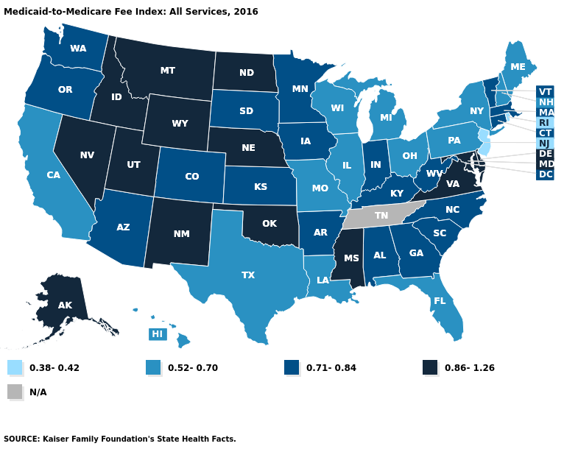
Medicaid-to-Medicare Fee Index (2016)

Slide 121
“Payments for pediatric health care services should be structured to achieve parity with payments for similar services for adults. In particular, Medicaid payments for services to children and young adults should be set at a minimum to Medicare payments made for the care of adults. A service provided to a child is not less complicated or time consuming than a similar service rendered to an adult because the child is younger or smaller; in fact, pediatric services not infrequently require greater effort because of a higher degree of medical complexity or procedural difficulty.”

Slide 122
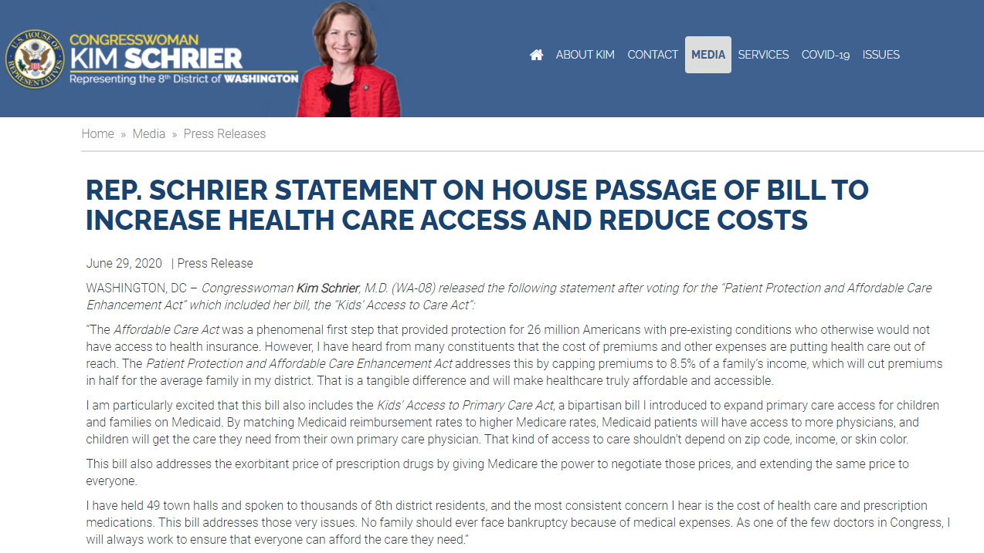

Slide 124
Economic Strategy Topic Areas
Financial Burden
  Target new strategies to minimize debt burden
Compensation and Revenue Stream
  Develop strategies to achieve greater parity with adult providers and greater parity among procedural and non-procedural pediatric subspecialists
Children’s Hospital GME
  Develop strategies to achieve parity with Medicare GME

Slide 125
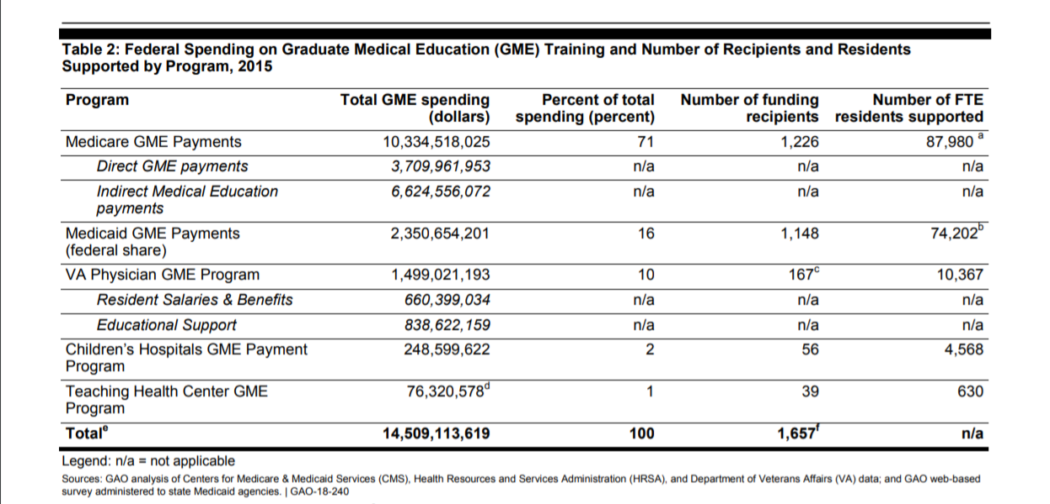

Slide 126
Children’s Hospitals GME
Long-term goal is parity with Medicare GME
Funding for CHGME per trainee half of Medicare GME
Represents 2% of total medical graduate spending
Source :1 Dobson| DaVanzo, Comparative Analysis of GME Funding Programs for Children’s Hospitals and General Acute Care Teaching Hospitals, updated March 2019

Slide 127
Questions for Discussion
How do we communicate the risk of not having pediatric subspecialists in terms of the implications for children’s health to federal/state legislators, Medicaid programs and payors?

Slide 128
Pediatrics 2025: The AMSPDC Workforce Initiative
Pediatrics 2025:
The AMSPDC Workforce Initiative
Domain 3 Report-Out
@AMSPDC
#Peds2025Workforce

Slide 129

Domain # 4 - Other Considerations for Attracting Diverse, High Quality Medical Students into Pediatrics

Slide 130

Domain # 4 - Other Considerations for Attracting
Diverse, High Quality Medical Students into Pediatrics
Advocacy
Update on work accomplished:
AAMC Graduates Entering Categorical Pediatrics Programs by Medical School and Graduation Year, 2008-2009 through 2017-2018
Pre-clerkship Collaborative: survey for 4th year medical students to assess factors influencing their decision in future career choice, with the ultimate goal of optimizing exposure and activities to encourage medical students to choose a career in Pediatrics.
Career Advising Collaborative: Primer for Career Advisors, newsletter, Career Advising in the Pre-clinical years, Creation of a Peer Career Advisor Network
COMSEP Group: Recruiting the Best: Attracting Phenomenal Medical Students into Pediatrics

Slide 131
Domain # 4 - Other Considerations for Attracting
Diverse, High Quality Medical Students into Pediatrics
Advocacy
Key areas of focus: Determine best practices for advocating for and recruiting medical and osteopathic students to Pediatrics
Collaboration: AMSPDC, AACOM, APPD, COMSEP, ABP

Slide 132
Domain # 4 - Other Considerations for Attracting
Diverse, High Quality Medical Students into Pediatrics
Advocacy
Short term goals
Call to community to see what Medical and Osteopathic schools are doing to promote Pediatrics as a career choice - 1 year
  Connect with the top 10 allopathic medical schools that have had the highest percentage of medical students entering pediatrics (with the AAMC data received by AMSPDC) to learn what they do. COMSEP – 1 year.
  Connect with Osteopathic schools with highest percentage of osteopathic students entering pediatrics to learn what they do - 1 year

Slide 133
Domain # 4 - Other Considerations for Attracting
Diverse, High Quality Medical Students into Pediatrics
Advocacy
Long term goals:
Provide medical schools/osteopathic schools/department chairs/COMSEP members with a tool kit for promoting pediatrics to medical students - 2-3 years
Develop a national campaign for Choosing Pediatrics -2-5 years
  Create pediatric interest groups at medical and osteopathic schools - 1 year
  Increased incorporation of pediatric faculty and pediatric cases into the preclinical curriculum – COMSEP, AMSPDC - 3 years
  Increased shadowing/research/other experiences for pre-clinical medical students with pediatric faculty – COMSEP, AMSPDC - 2 years
  Tracking pediatric specific metrics (percentage of graduates matching in categorical pediatrics and combined pediatric programs) work with DOMAIN 2 for this data -3-5 years
  Creative approaches to highlighting Pediatrics as a career choice – 2-3 years

Slide 134
Domain # 4 - Other Considerations for Attracting
Diverse, High Quality Medical Students into Pediatrics
Marketing Strategy
Key areas of focus: Identify factors that influence medical student career decision making and then determine how to utilizing approaches and strategies that respond to factors important in medical and osteopathic student career decision-making process.
Collaboration: AMSPDC, AACOM, APPD, COMSEP, FuturePedsRes
Short term goals:
Identify when, how and why medical and osteopathic students decide to choose Pediatrics and Pediatric Subspecialties - 1-2 years
Long term goals:
Develop strategies to market the field of pediatrics to high-quality students with a national campaign for Choosing Pediatrics -2-5 years

Slide 135
Domain # 4 - Other Considerations for Attracting
Diverse, High Quality Medical Students into Pediatrics
Early Exposure
Update on work accomplished: Early Exposure Action Team (with CoPS)
Key areas of focus: Work towards increasing and implementing early and adequate exposure to Pediatrics at various critical touch points, including high school and college, medical/osteopathic school pre-clinical and clinical curricula, early in residency training, etc.
Collaboration: AMSPDC, AACOM, APPD, COMSEP CoPS

Slide 136
Domain # 4 - Other Considerations for Attracting
Diverse, High Quality Medical Students into Pediatrics
Early Exposure
Short term goals:
Survey subspecialty awareness survey: survey being finalized to collect information on how subspecialties increase awareness about pediatrics and pediatric subspecialties with the aim of recruiting to fellowship, develop toolkit of programs and initiatives in use for the CoPS website. – 1 year
Collect data on existing programs that expose high school and college students to medicine - 1-2 years

Slide 137
Domain # 4 - Other Considerations for Attracting
Diverse, High Quality Medical Students into Pediatrics
Early Exposure
Long term goals:
Develop strategies to recruit Pediatric residents to subspecialties – 3-5 years
Increased incorporation of pediatric faculty and pediatric cases into the preclinical curriculum – COMSEP, AMSPDC - 3 years
Partner or create mini medical schools, present clinical cases to high schools (including underserved areas) and colleges to exposure these students early to Pediatrics - 2-5 years

Slide 138
Domain # 4 - Other Considerations for Attracting Diverse, High Quality Medical Students into Pediatrics
Recruitment/Outreach
Update on work accomplished
Assessment and Evaluation Collaborative: “Predictors of Success: From Medical Student to Pediatric Resident” funded by a grant from APPD LEARN/COMSEP, data being collected to determine if there are any correlates with performance in pediatric residency
Key areas of focus: Improve the pediatric pipeline by creating strategies that engage high school students, college students, and preclinical medical/osteopathic students
Collaboration: AMSPDC, AACOM, APPD, COMSEP CoPS

Slide 139
Domain # 4 - Other Considerations for Attracting Diverse, High Quality Medical Students into Pediatrics
Recruitment/Outreach
Short term goals
Collect data on existing programs that expose high school and college students to medicine - 1-2 years
Collect data on what programs are currently doing to promote medicine overall and how can we highlight pediatrics better? – 1-2 years

Slide 140
Domain # 4 - Other Considerations for Attracting Diverse, High Quality Medical Students into Pediatrics
Recruitment/Outreach
Long term goals
Partner or create mini medical school, present clinical cases to high schools (including underserved areas) and colleges to exposure these students early to Pediatrics - 2-5 years
Early exposure to pediatric specific STEM programs – 2-5 years
Enhanced work with organizations such as the SNMA, and partnering with COMSEP to achieve greater recruitment of students into Pediatrics. - 2-5 years

Slide 141
Domain # 4 - Other Considerations for Attracting Diverse, High Quality Medical Students into Pediatrics
Overall workplan
We welcome guidance from all Workforce Stakeholders to freely share ideas, programs in medicine that have worked and not worked as we develop a national campaign for Choosing Pediatrics .
COMSEP has ACCESS to the medical students; we’d like to develop a plan for each medical school to promote pediatrics as a career.

Slide 142
Breakout Questions: Domain 4
What does a successful Choosing Pediatrics campaign look like?
Should learners (students, residents, fellows) be invited to join this initiative?
What elements of Pediatrics should be highlighted to attract learners to the field?
Once these elements are identified what are the best methods to highlight the elements and get the word out?
How do we identify and get access to high quality, diverse learners?
What resources are needed to target high quality, diverse learners? Access to research pathways, advocacy, etc.?

Slide 143
Pediatrics 2025: The AMSPDC Workforce Initiative
Pediatrics 2025:
The AMSPDC Workforce Initiative
Domain 4 Report-Out
@AMSPDC
#Peds2025Workforce

Slide 144
Next Steps
NextGenPediatricians
#FuturePedsRes

Slide 145
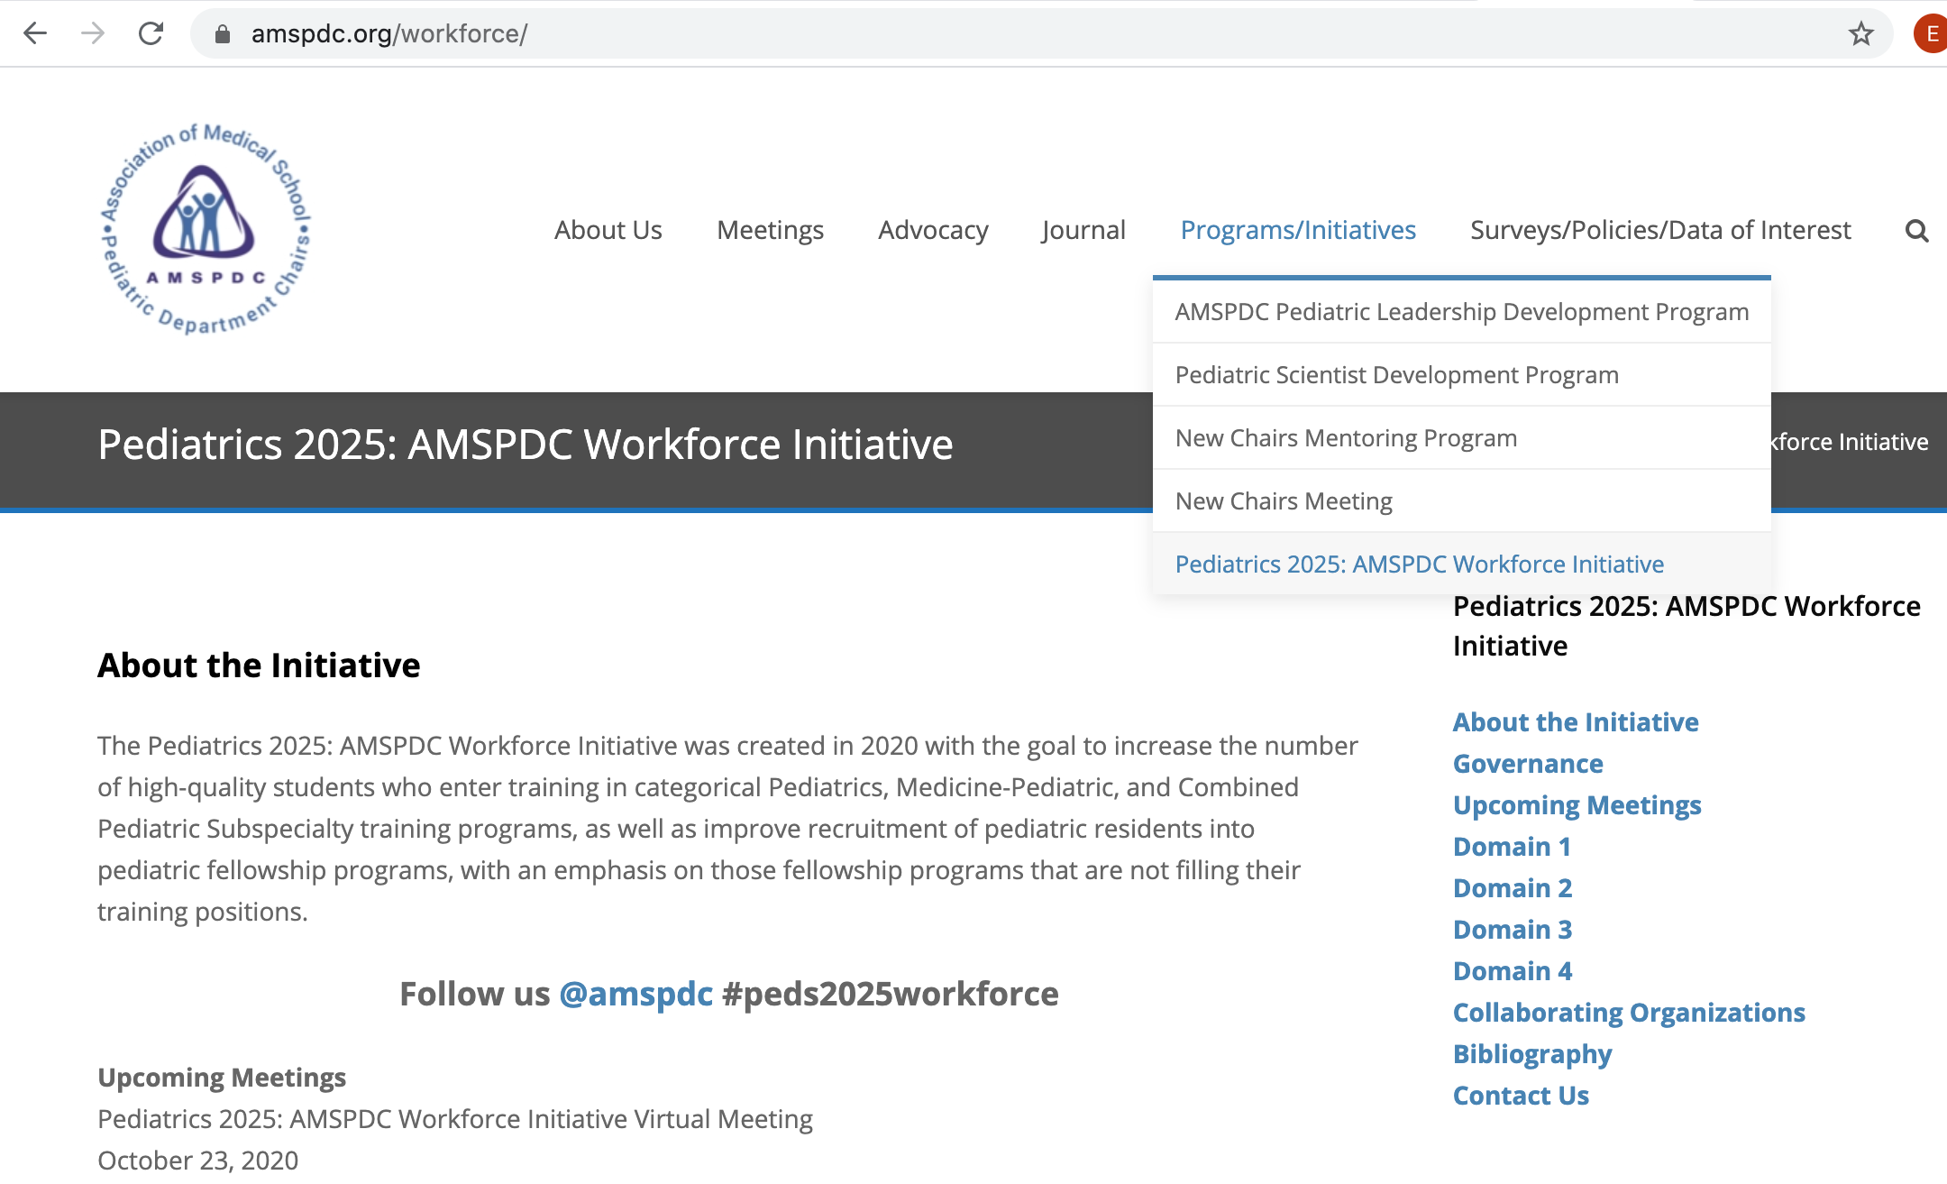
Pediatrics 2025: The AMSPDC Workforce Initiative
amspdc.org/workforce
@AMSPDC
#Peds2025Workforce

Slide 146
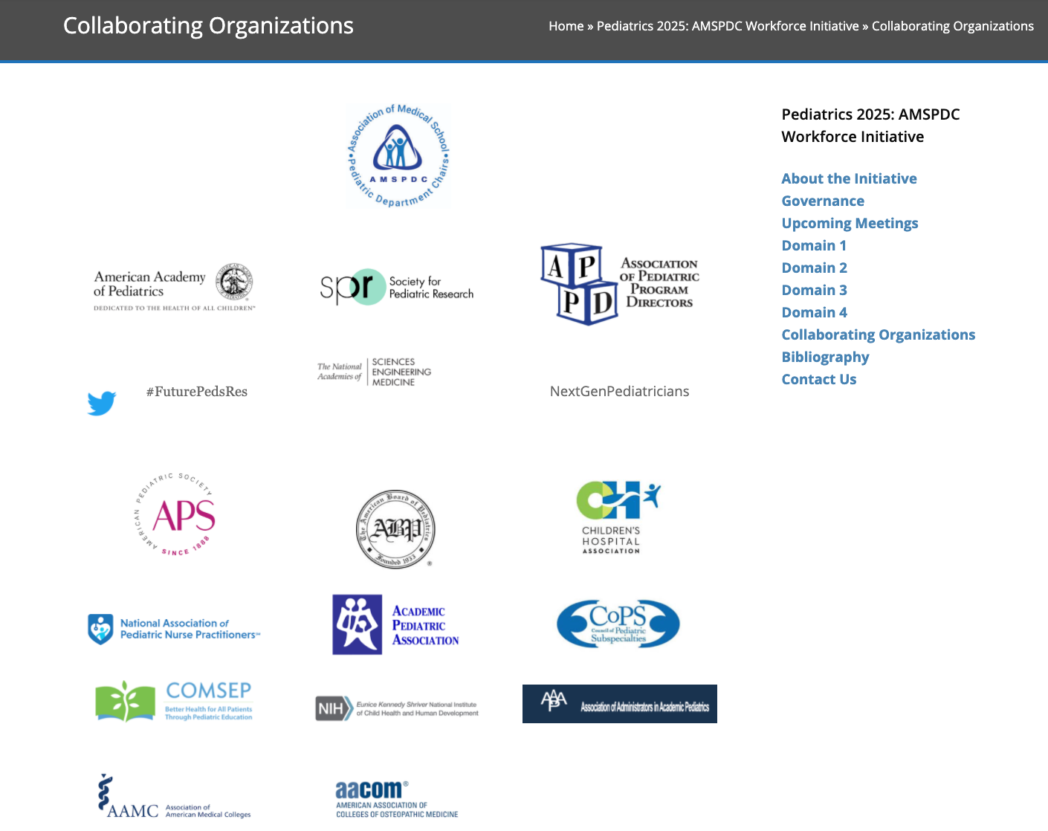
Pediatrics 2025: The AMSPDC Workforce Initiative
amspdc.org/workforce
@AMSPDC
#Peds2025Workforce

Slide 147
Pediatrics 2025: The AMSPDC Workforce Initiative
Discussion
Are we headed in the right direction?
What have we missed?
Moving ahead how do we maintain a focus on actions?
Continue to share your notes and thoughts with Bob and Laura.
Summary of today; next Summit in ~ 6 months.
@AMSPDC
#Peds2025Workforce

Slide 148

Pediatrics 2025: The AMSPDC Workforce Initiative
Thank you!
@AMSPDC
#Peds2025Workforce

